Slide 1
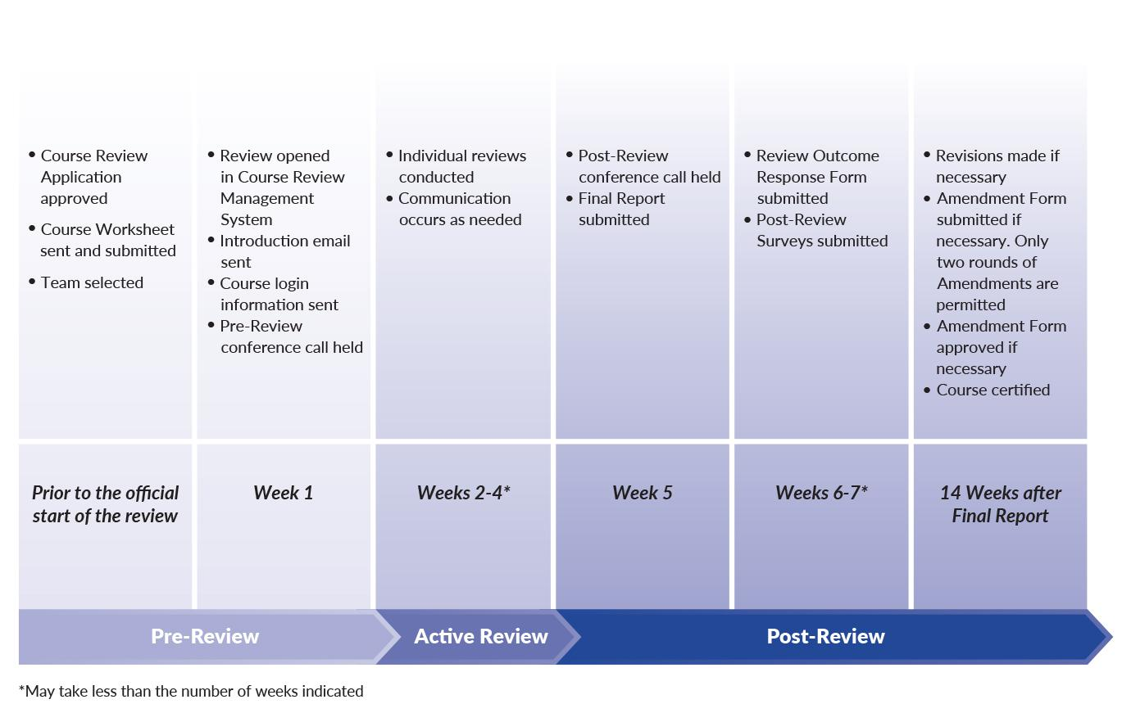
Course Review Timeline
Notes:
Directions to Facilitator:
QM offers this timeline to help review teams manage their reviews. Some teams complete their work in less time. A key deadline, however, is that if amendments are necessary for the course to meet expectations, those amendments must be made and approved within 14 weeks after the Final Report is submitted.
Many participants wonder how long it takes to conduct the actual review of the course. Actual review time varies widely. In general, the first review takes longer than subsequent reviews (in other words, reviewers become more efficient as they gain experience during reviews). Factors affecting the review time include familiarity with the discipline, the learning management system, the review process, and the overall organization of the course being reviewed.
QM encourages the use of new reviewers on teams to enable them to gain the experience of serving on a peer review.
Below is the complete Course Review Timeline in an outline format:
Pre-Review
Prior to the official start of the review
Course Review Application approved
Course Worksheet sent and submitted
Team selected
Week 1
Review opened in Course Review Management System
Introduction email sent
Course login information sent
Pre-Review conference call held
Active Review
Weeks 2-4 (May take less than the number of weeks indicated)
Individual Reviews conducted
Communication occurs as needed
Post-Review
Weeks 5
Post-Review conference call held
Final Report submitted
Weeks 6 -7 (May take less than the number of weeks indicated)
Review Outcome Response Form submitted
Post-Review Surveys submitted
14 Weeks after Final Report
Revisions made if necessary
Amendment Form submitted if necessary. Only two rounds of Amendments are permitted
Amendment Form approved if necessary
Course certified

