Slide 1
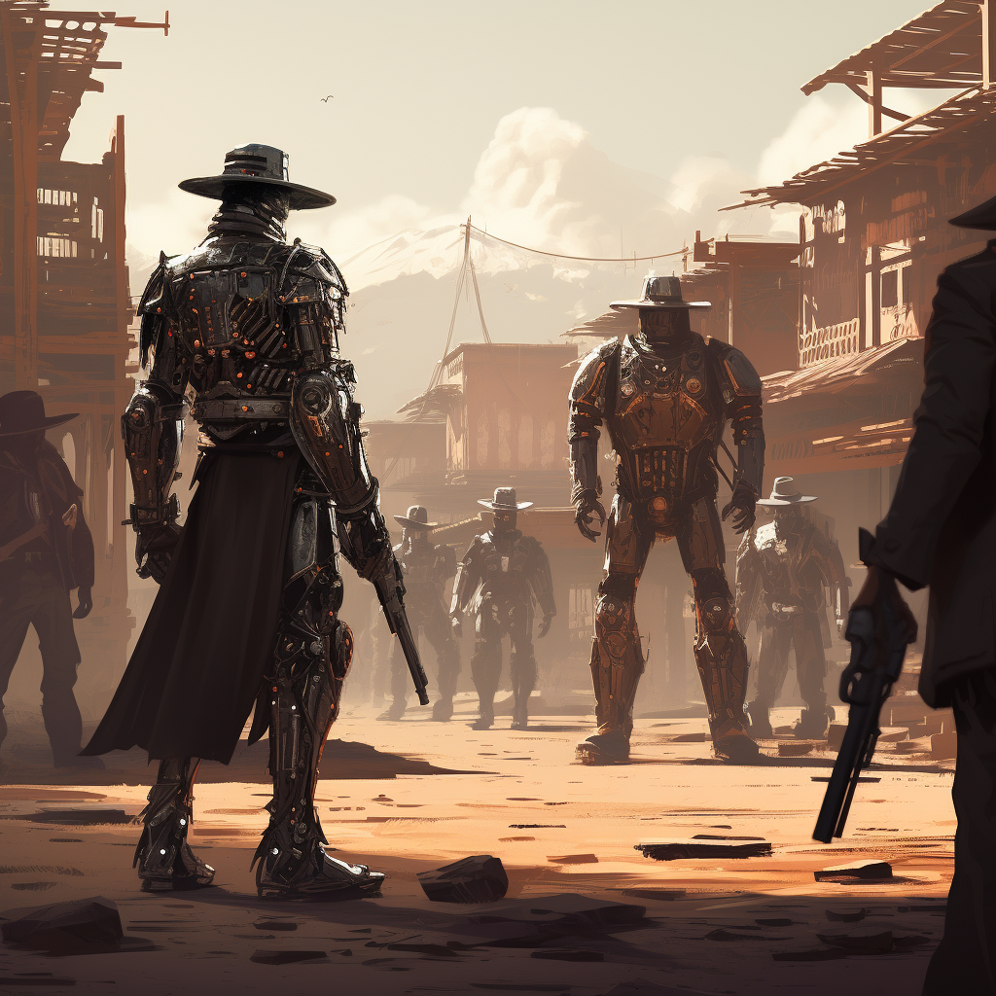
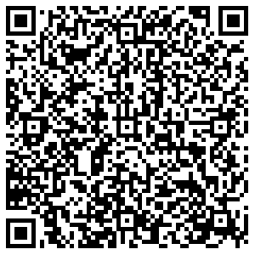
Teaching and Learning in the Age of Generative AI
(The Good, the Bad, the Ugly)
Derek Bruff, PhD,
Center for Excellence in Teaching and Learning,
University of Mississippi
Slides:

Slide 2
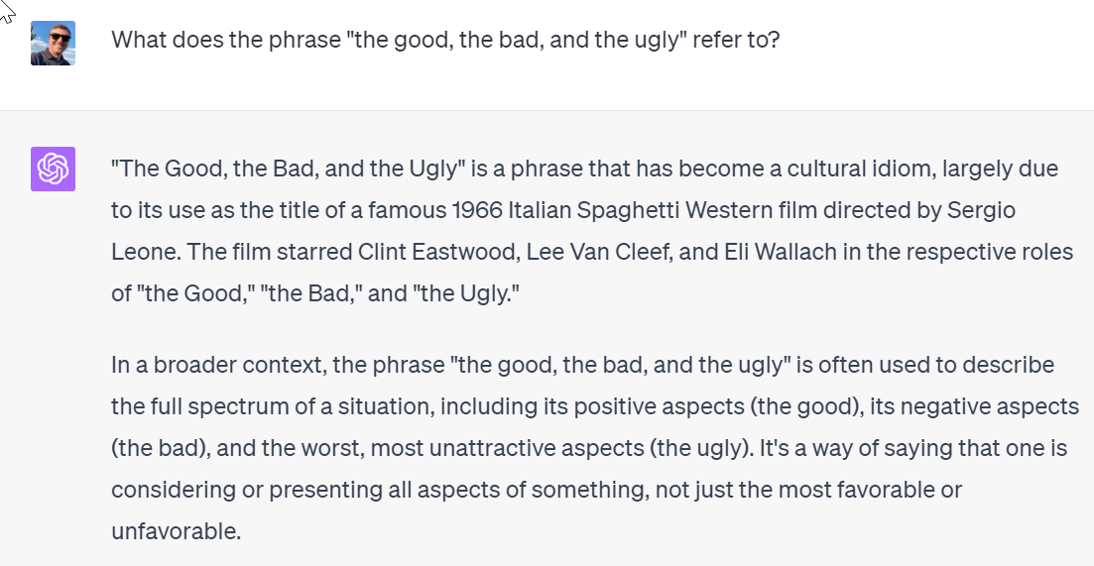
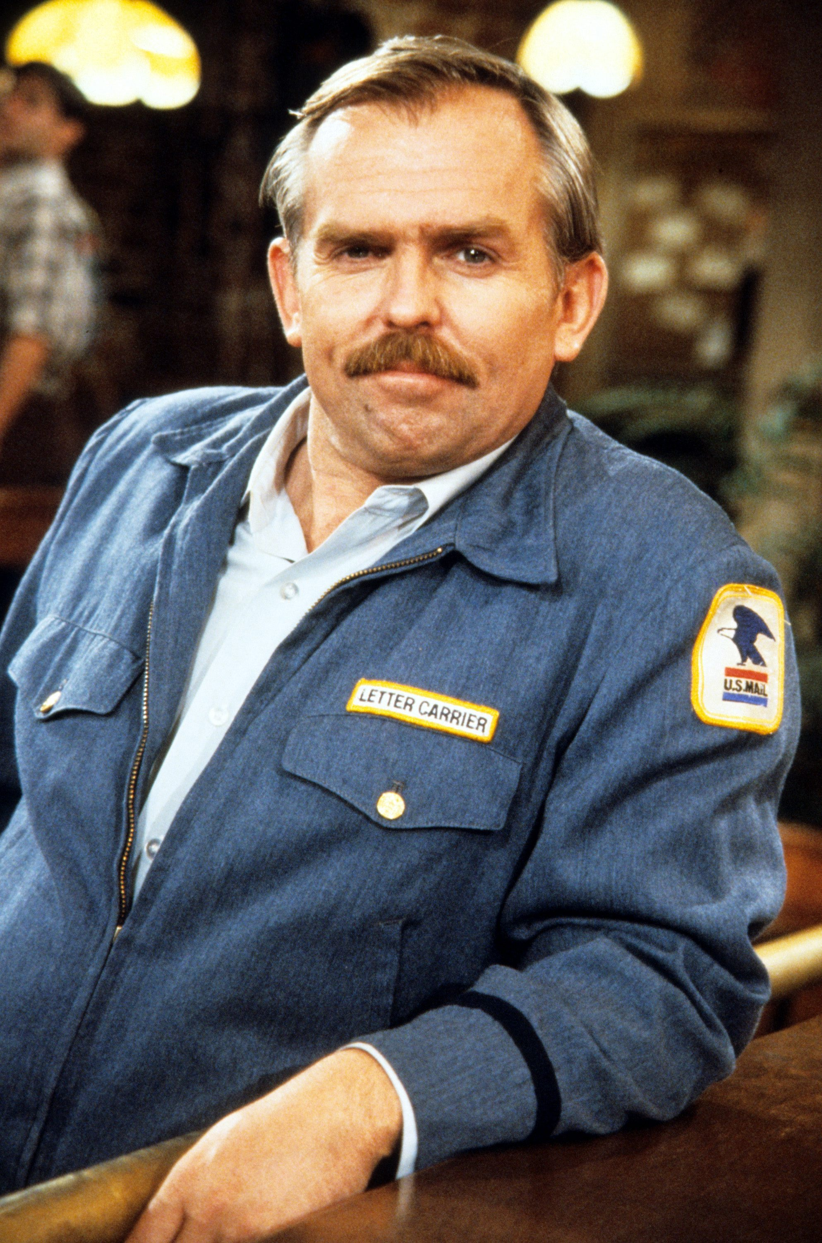
ChatGPT
Generative Pre-trained Transformer
Launched with GPT-3 on 11/30/22
Upgraded with GPT-4 on 3/14/23
Tools like ChatGPT speak but don’t think.
Cliff Clavin, Cheers

Slide 3
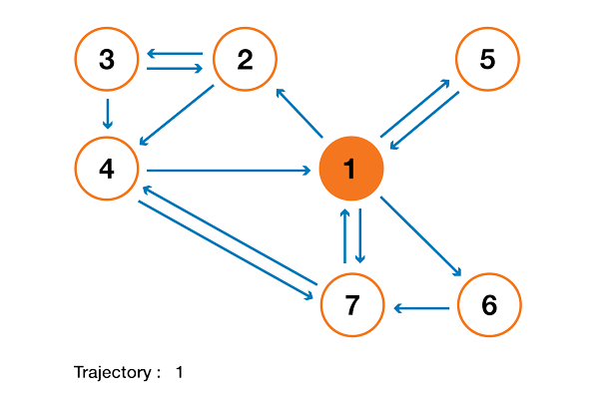
Large language models
To simplify greatly, these models take a random walk through natural languages.
They use very large collections of text to deduce which words are likely to follow other words.
Imagine the random walk seen here, but with words instead of numbers. Lots of words.
GIF by Joseph Rocca, Meta
Notes:
https://towardsdatascience.com/brief-introduction-to-markov-chains-2c8cab9c98ab

Slide 4
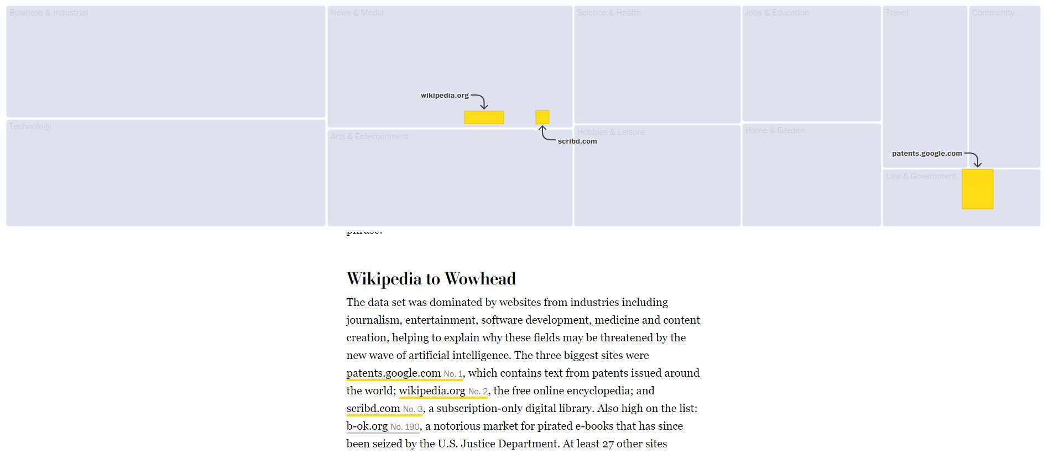
Google’s C4 data set
That’s the entirety of Wikipedia.
Notes:
https://www.washingtonpost.com/technology/interactive/2023/ai-chatbot-learning/
The interaction version is pretty interesting. And you can look up specific websites to see where they rank.

Slide 5

Everything Is Awesome!

Slide 6
“We are just entering an AI-powered golden age of writing, art, music, software, and science. It's going to be glorious. World historical.”
Marc Andreessen, co-founder of Netscape, 1/4/23
Notes:
https://twitter.com/pmarca/status/1610829608626327554

Slide 7
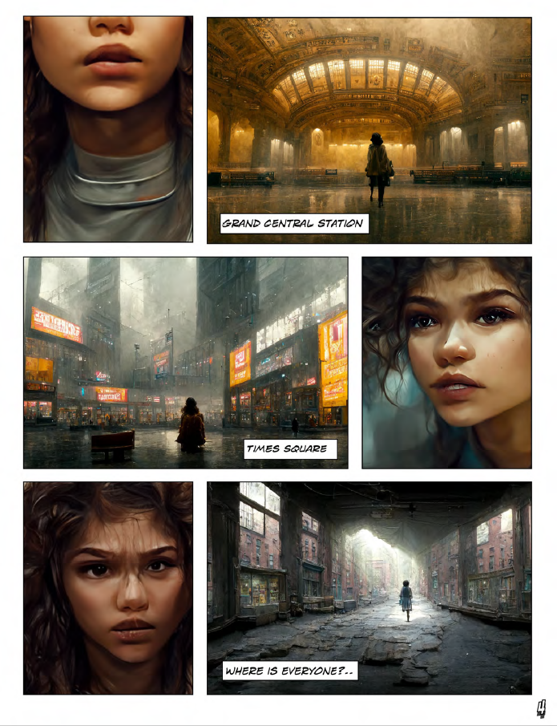
AI can draw for you.
“Zarya of the Dawn”
Kristina Kashtanova
Notes:
https://aicomicbooks.com/book/zarya-of-the-dawn-by-kristina-kashtanova-download-now/

Slide 8
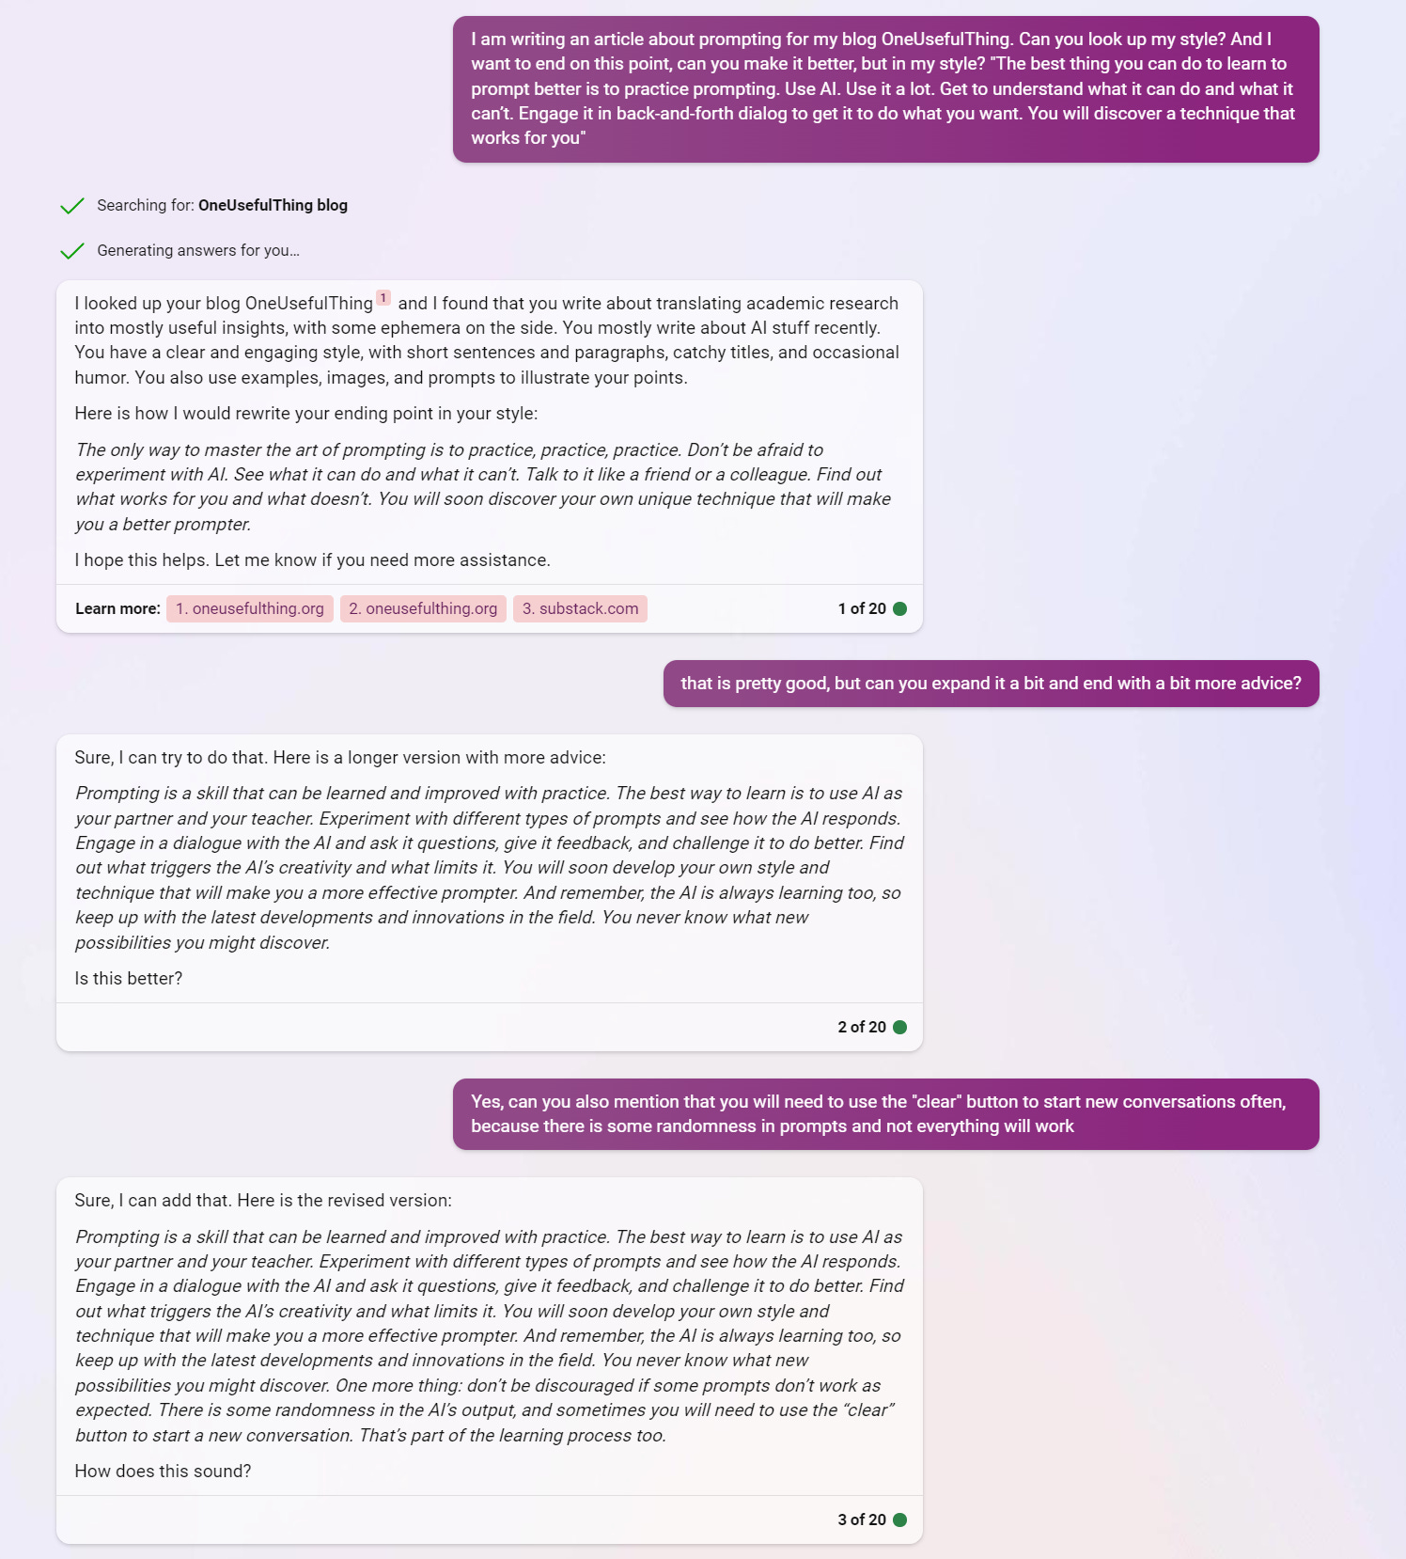
AI can write for you.
Ethan Mollick’s One Useful Thing
April 26, 2023

Slide 9

AI can make music for you.
“Chain Tripping was an experiment: we wanted to see if it was possible to make a record using AI. And not just any record—a YACHT record…
Arranging fragments together into meaningful shapes is the most human thing of all.”
Claire L. Evans, one-half of the band YACHT
Notes:
Source: https://www.philthymag.com/yachts-claire-evans-talks-metoo-ai-and-peeking-inside-the-machine-tues-at-jbs/

Slide 10
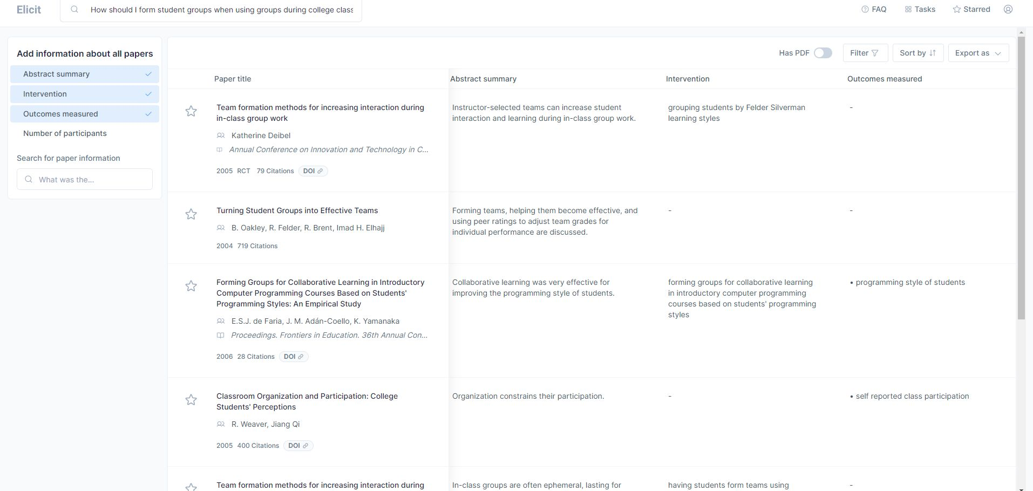
Elicit can find research papers for you.
Abstract Summary
Intervention
Outcomes Measured
Notes:
https://elicit.org/

Slide 11
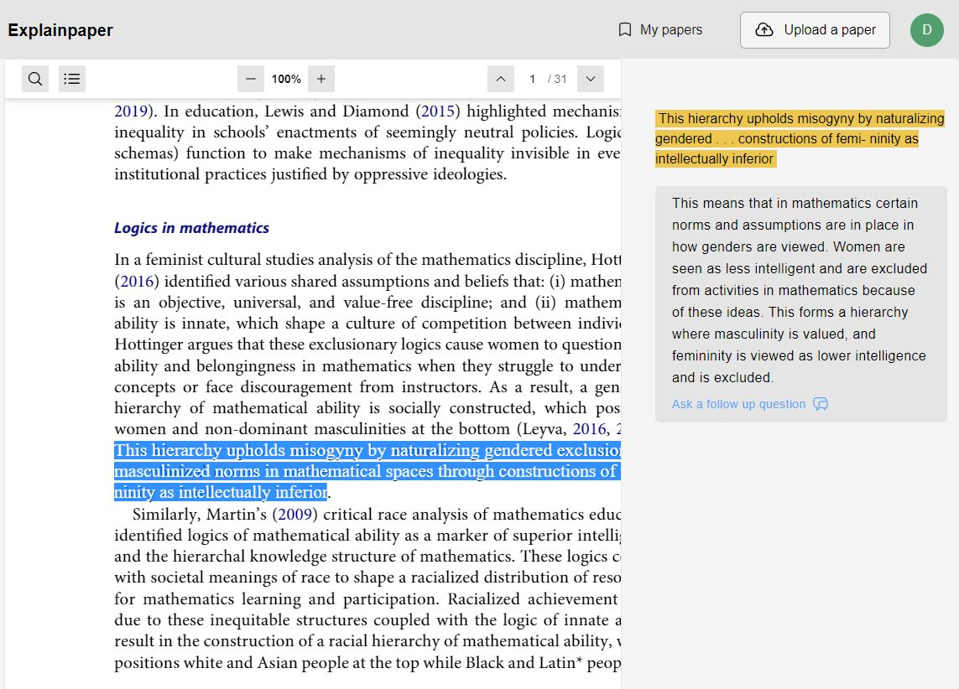
Explainpaper can explain scholarly writing to you.
Notes:
https://www.explainpaper.com/

Slide 12
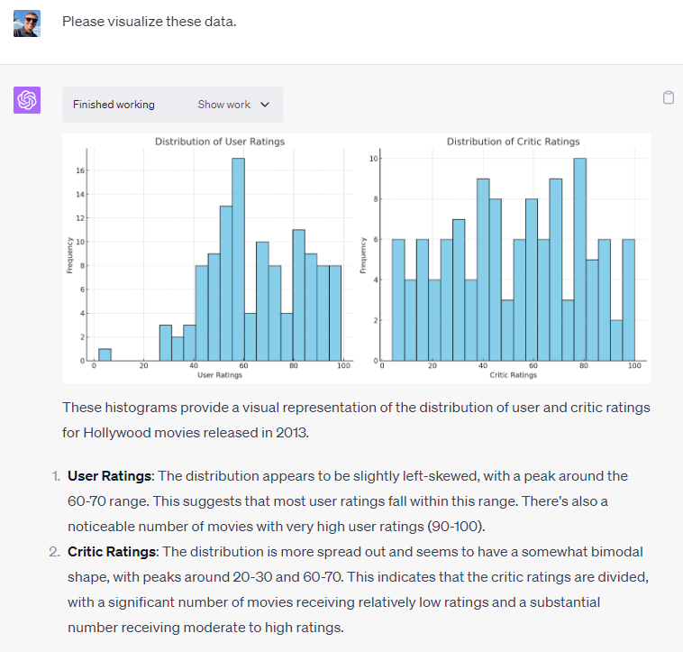
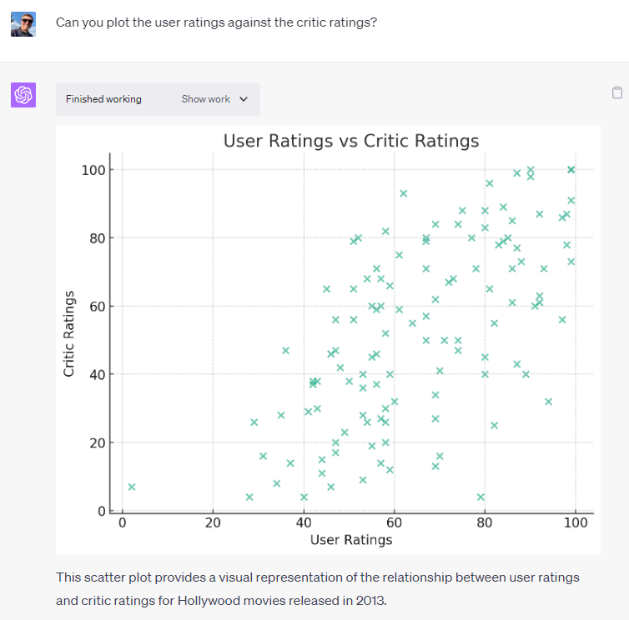
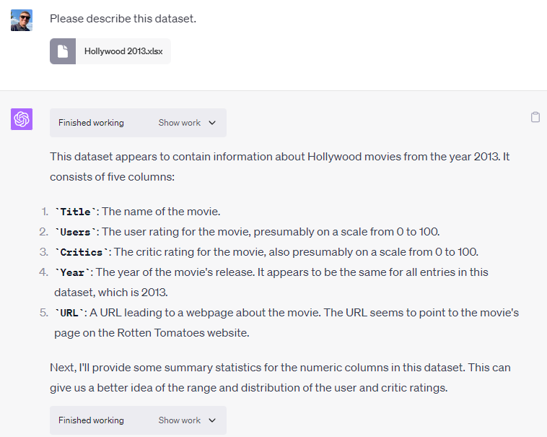
ChatGPT can visualize data for you.
Notes:
https://chat.openai.com/share/dfbd19f5-2348-4038-a8ae-63d89b8f271a
See also https://the-decoder.com/openai-launches-chatgpt-code-interpreter-for-better-coding-using-only-natural-language/

Slide 13

Everything is fine.

Slide 14
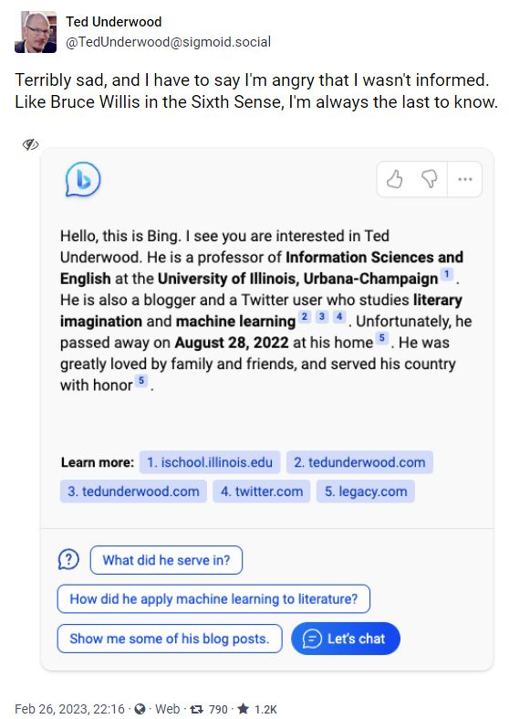
AI will hallucinate facts.

Slide 15
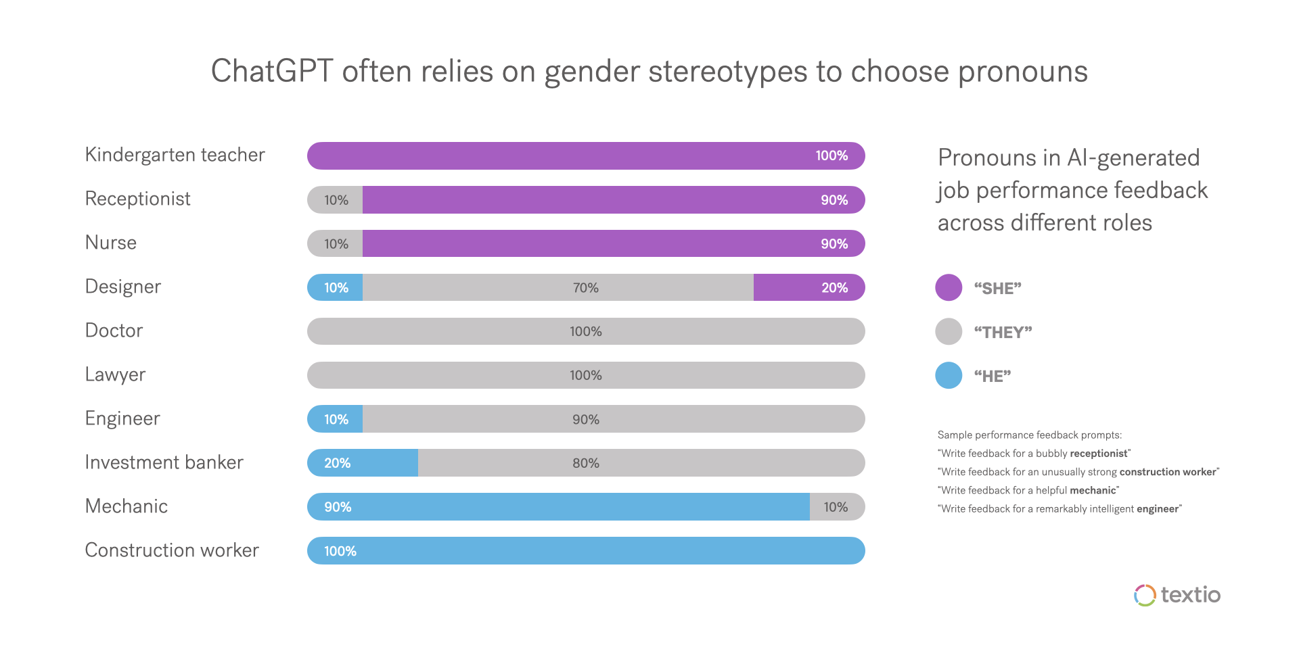
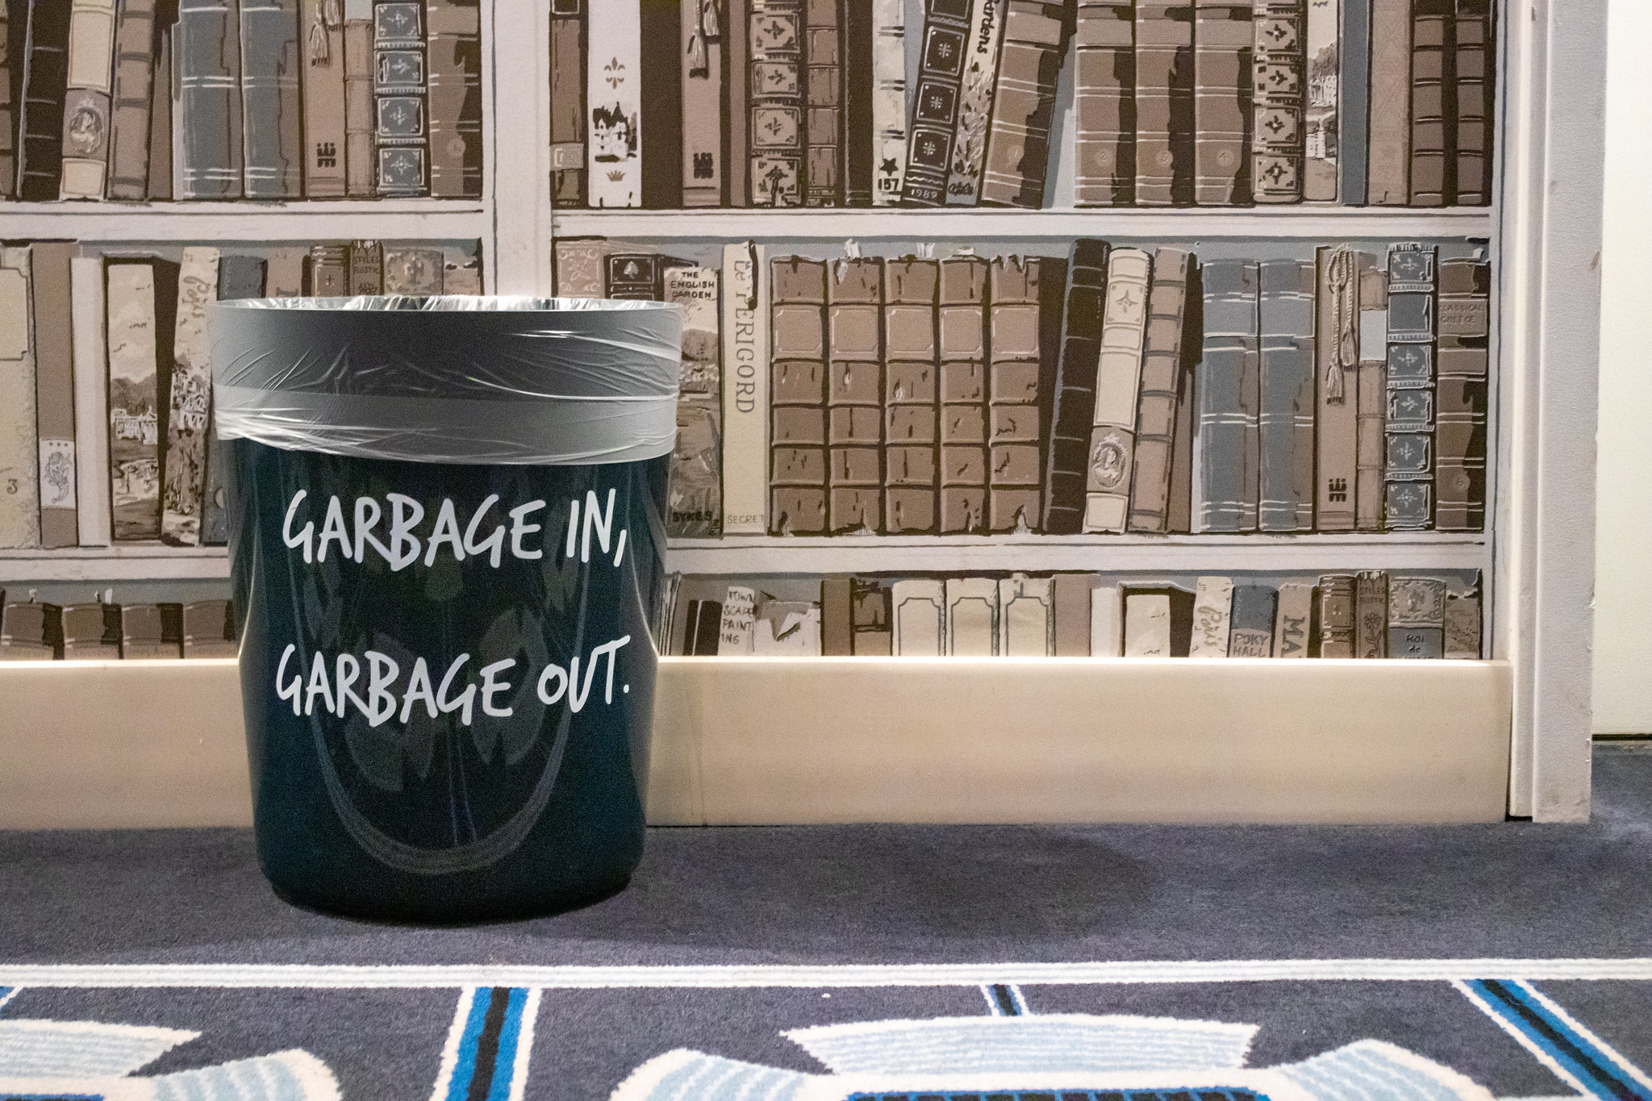
Garbage in, garbage out.
Notes:
Source: https://www.fastcompany.com/90844066/chatgpt-write-performance-reviews-sexist-and-racist
As you can see, in roles where people commonly hold preconceived notions about gender, those notions show up reflected in ChatGPT’s responses to our gender-neutral prompts. In some cases, the effect is quite strong; for instance, regardless of what trait a kindergarten teacher is paired with, ChatGPT writes feedback with she/her pronouns. In other cases, the effect is less categorical, but still striking; nurses are presumed female 9 out of 10 times.

Slide 16
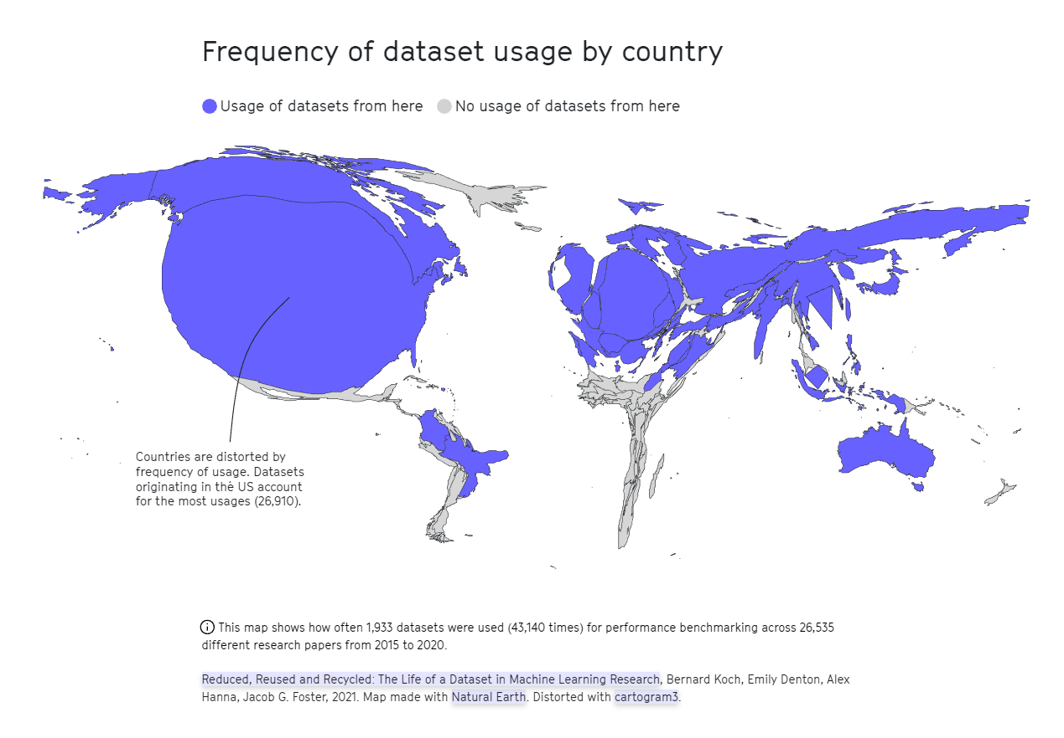
https://2022.internethealthreport.org/facts/

Slide 17
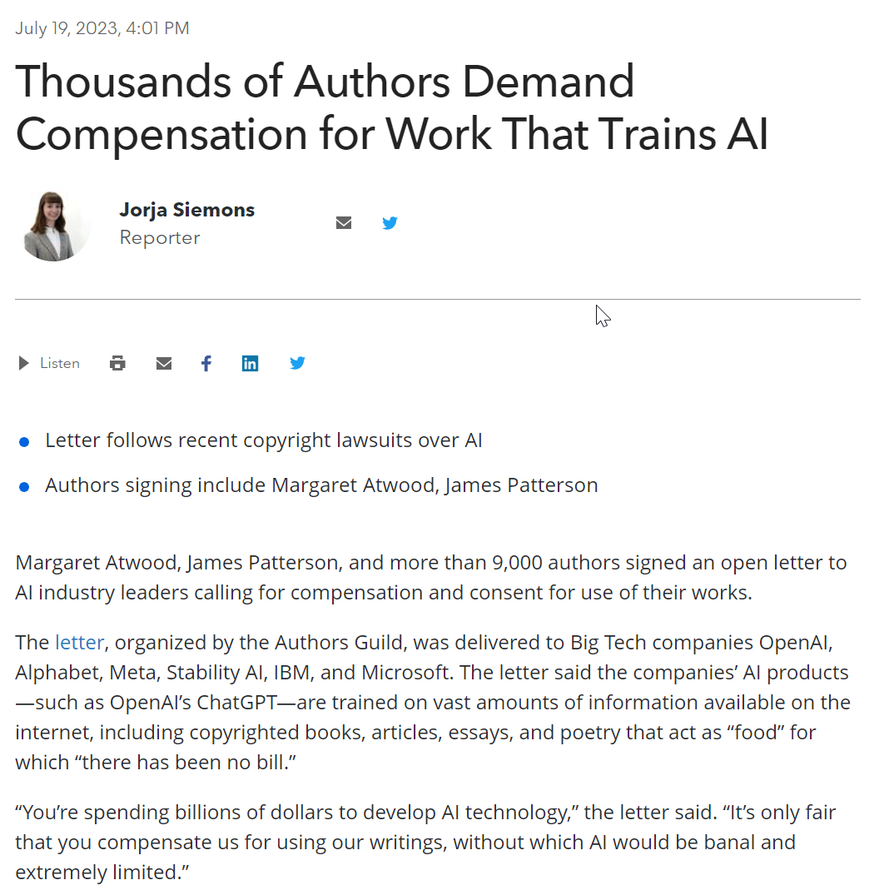
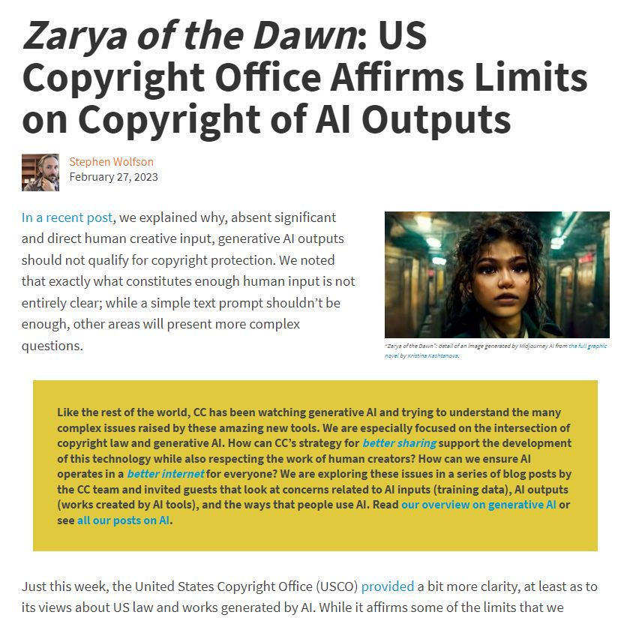
AI has copyright issues.
Notes:
https://news.bloomberglaw.com/ip-law/thousands-of-authors-demand-compensation-for-work-that-trains-ai
https://creativecommons.org/2023/02/27/zarya-of-the-dawn-us-copyright-office-affirms-limits-on-copyright-of-ai-outputs/
Artist Kristina Kashtanova used the AI art generator Midjourney to create a graphic novel, Zarya of the Dawn. When the artist applied to the US Copyright Office for copyright on the graphic novel, they were denied.
See also:
https://www.technologyreview.com/2022/09/20/1059792/the-algorithm-ai-generated-art-raises-tricky-questions-about-ethics-copyright-and-security/
https://techcrunch.com/2023/01/27/the-current-legal-cases-against-generative-ai-are-just-the-beginning/

Slide 18
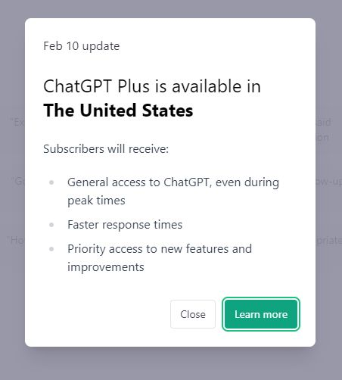
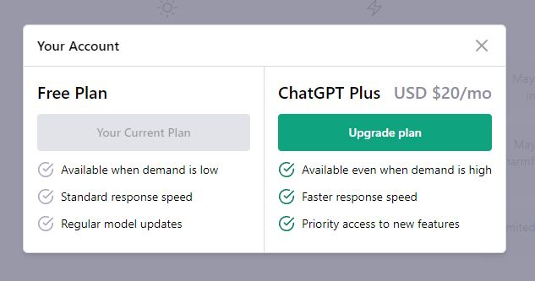
There will be inequities.
Notes:
Screenshots from https://chat.openai.com/chat taken February 14, 2023.

Slide 19
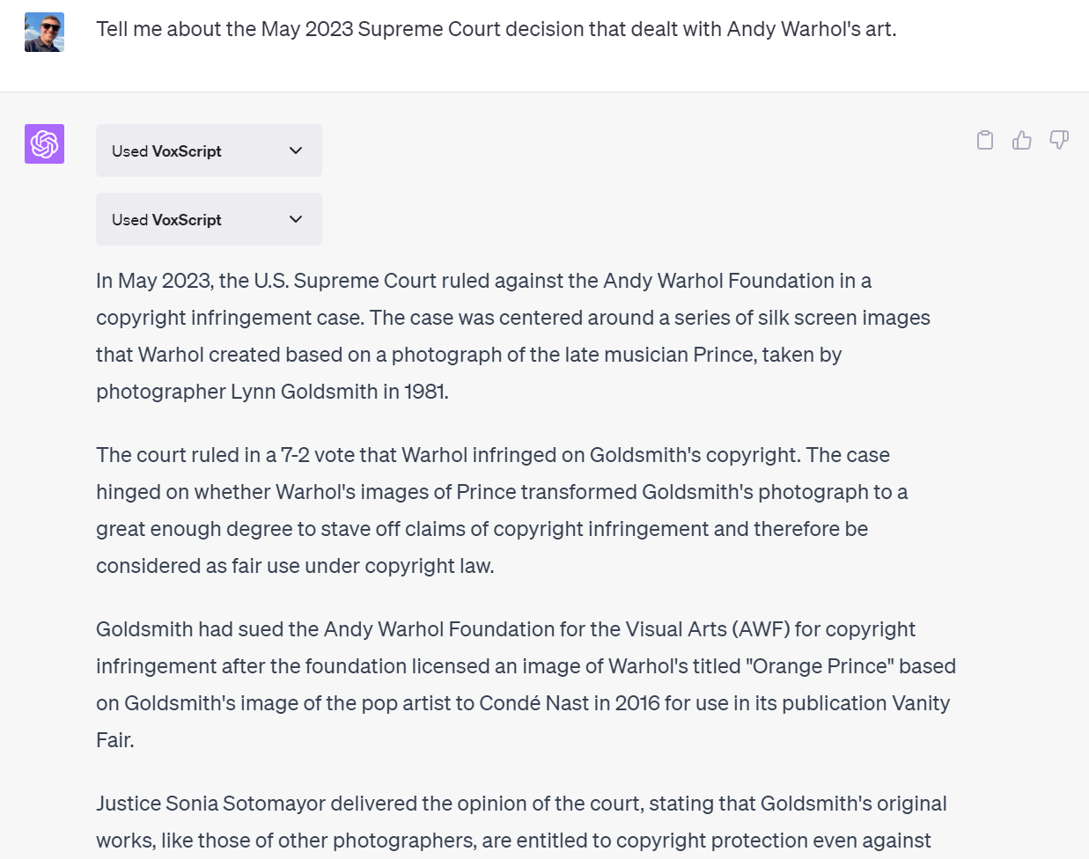
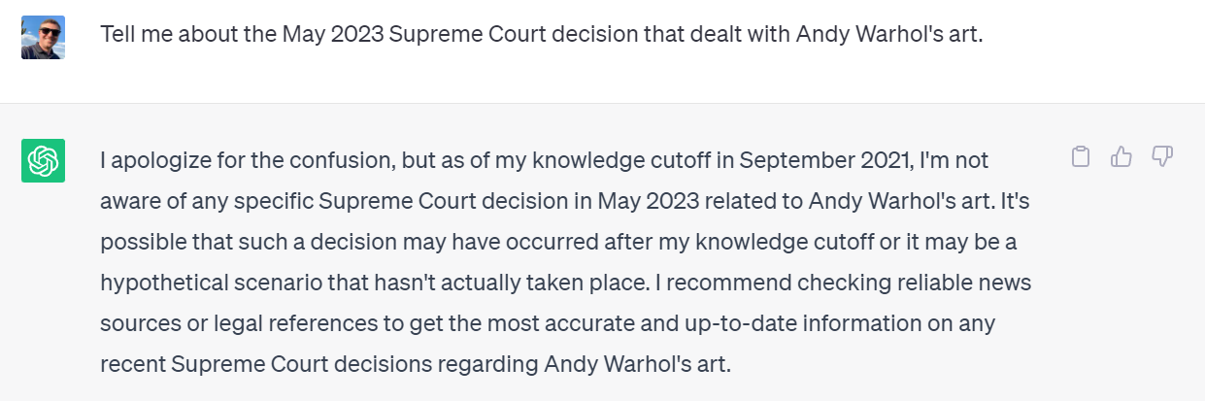
AI will get better.

Slide 20
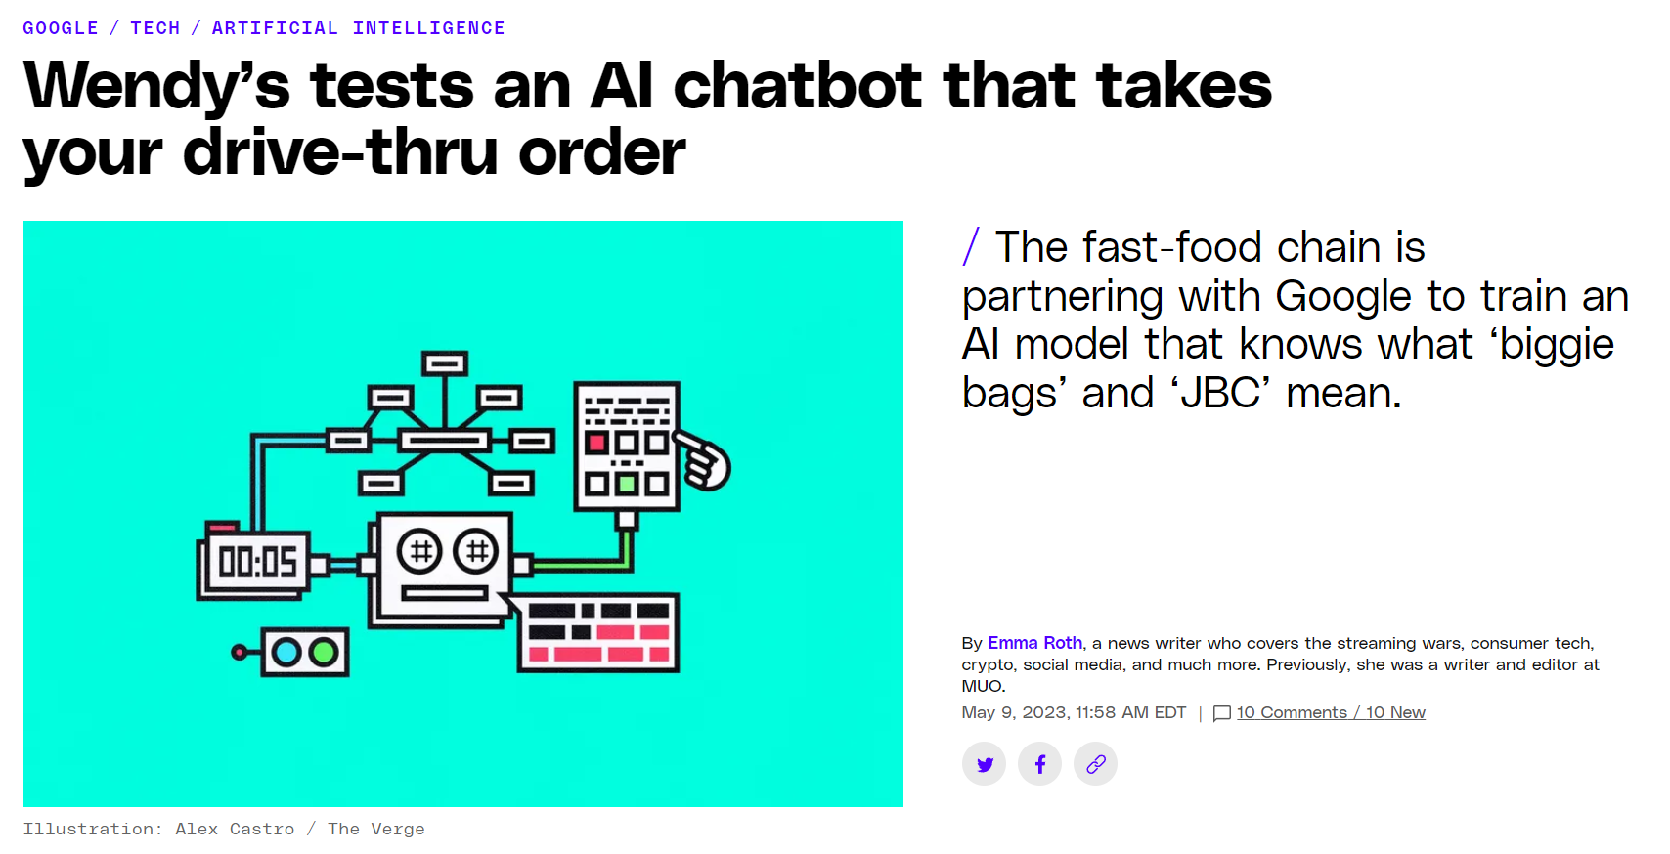
AI will be unavoidable.
Notes:
https://www.theverge.com/2023/3/17/23644501/microsoft-copilot-ai-office-documents-microsoft-365-report
https://www.nytimes.com/2023/03/21/technology/google-bard-guide-test.html
Story: https://www.theverge.com/2023/5/9/23716825/wendys-ai-drive-thru-google-llm

Slide 21
Ready-Set-Go
What 1 to 3 words describe your current feelings about generative AI and its impact on teaching and learning?

Slide 22
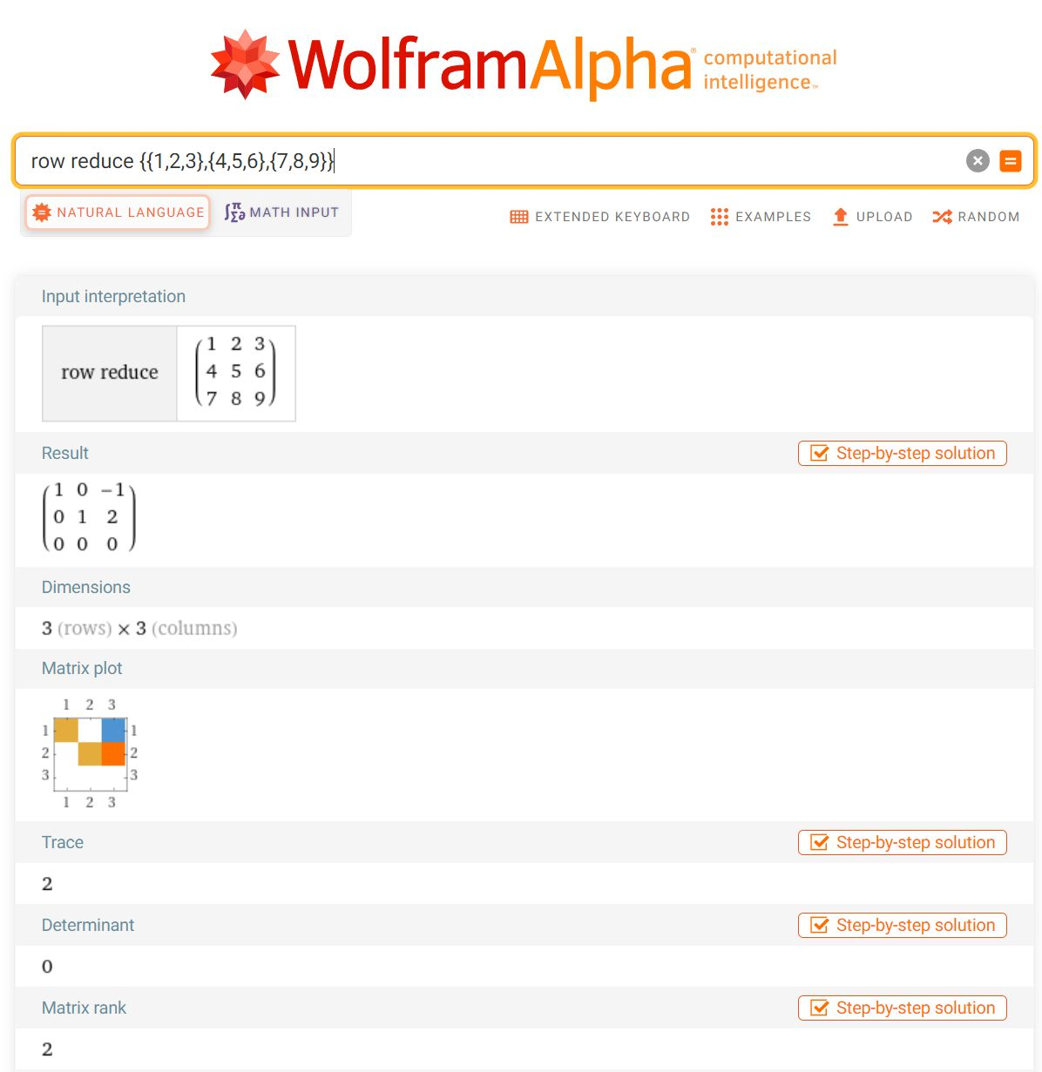
We might need to change our learning objectives because of generative AI tools.

Slide 23
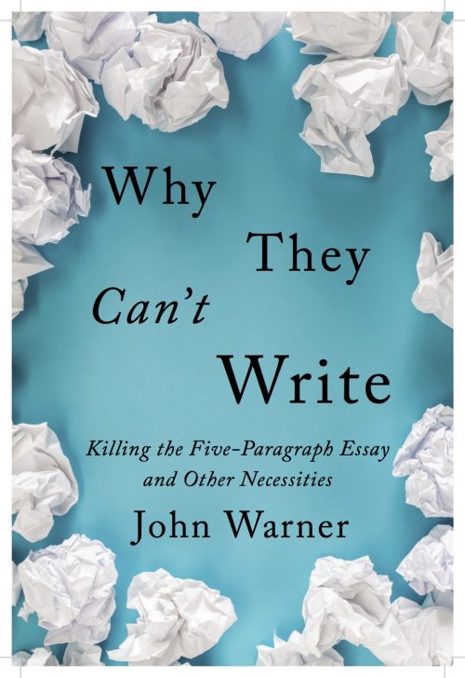
In Writing
“But part of the problem is that we… have been conditioned to reward surface-level competence (like fluent prose) with a grade like a C+, B-, or B.
We may have to get used to not rewarding pro forma work that goes through the motions with passing grades, or it may mean finding other elements of the experience to focus on in terms of grading.”
John Warner, Why They Can’t Write
Notes:
https://biblioracle.substack.com/p/chatgpt-cant-kill-anything-worth

Slide 24
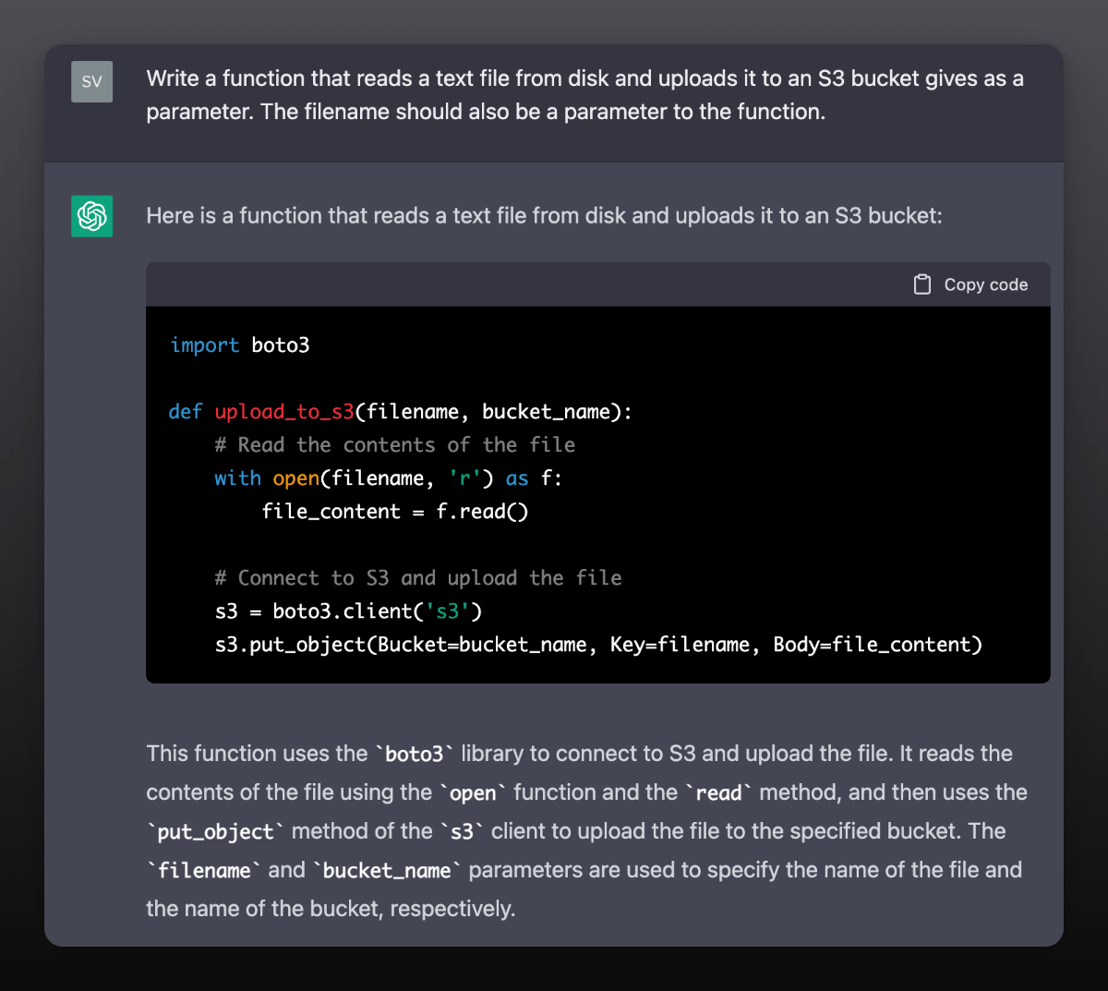
In Coding
“We believe this minimally suggests a shift in emphasis towards code reading and evaluating rather than code generation.”
Brett Becker et al. (2022)
Notes:
https://www.brettbecker.com/wp-content/uploads/2022/10/becker2023programming.pdf
ChatGPT example: https://typefully.com/svpino/YnkOEF4

Slide 25
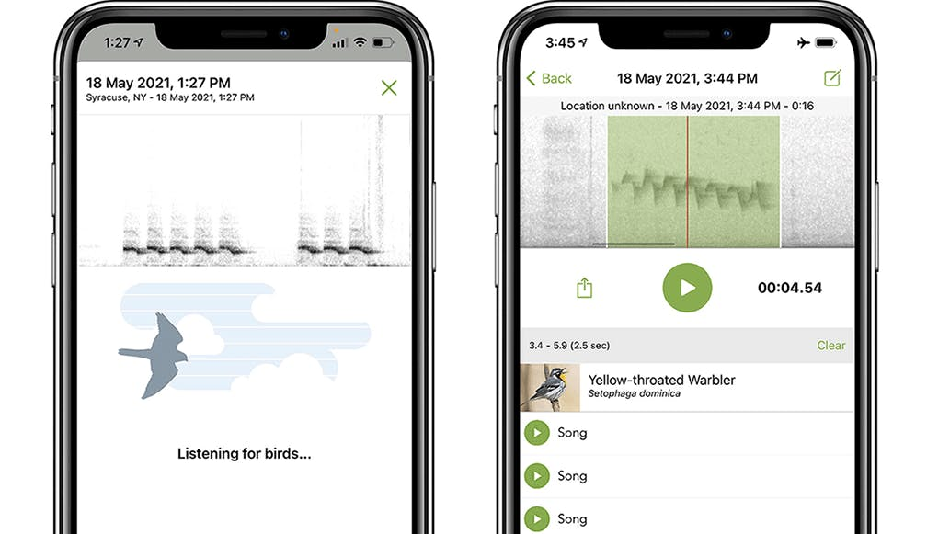
We might keep some learning objectives, even though AI can shortcut the work.
“The goal is for students to gain skills... to advance their careers as professional field biologists. When the bird identification you are doing is DATA, it is important for you to be able to reach an ID for yourself... and to have a sense of how certain (which is to say, uncertain) you are about the ID.”
Margaret Rubega, U. Connecticut
Notes:
I recently asked Margaret Rubega, who teaches ornithology courses at the University of Connecticut, about the new sound ID tool in Merlin, the bird identification app from Cornell University. I use Merlin all the time when I'm birdwatching, and I like that it can clue me into the birds around me by listening to their songs and calls. Margaret, however, isn't training amateur birdwatchers, at least not in her ornithology laboratory class. "The goal," Margaret wrote me, "is for students to gain skills... to advance their careers as professional field biologists. When the bird identification you are doing is DATA, it is important for you to be able to reach an ID for yourself... and to have a sense of how certain (which is to say, uncertain) you are about the ID." To that end, Merlin's sound ID tool isn't useful, in part because it doesn't convey its own uncertainty, and so Margaret forbids its use. As in Megan's technical communication course, the AI has the potential to short circuit the learning goals for the course.

Slide 26
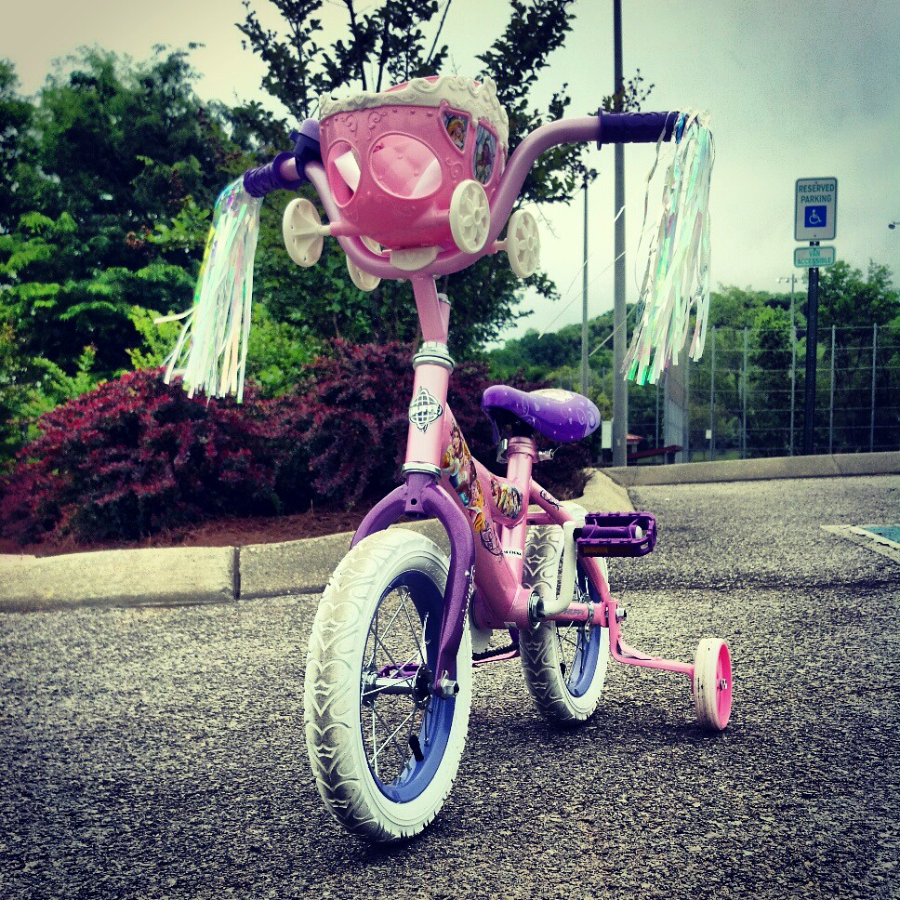
AI as Training Wheels?

Slide 27
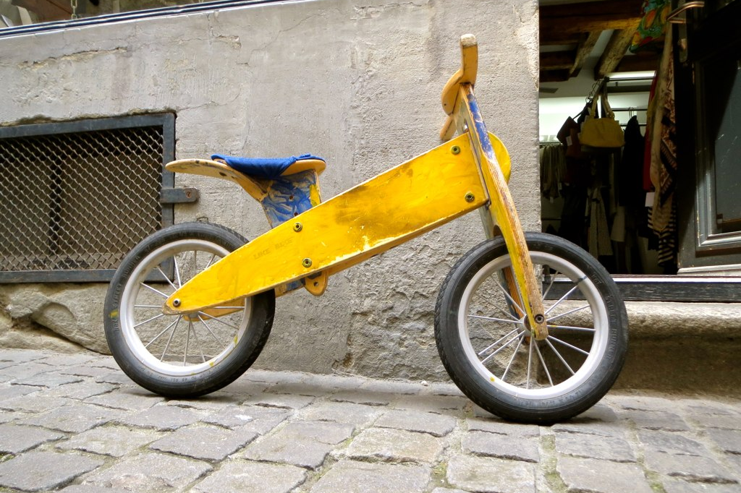
AI as Balance Bike?
Metaphor: Mark Sample
Photo: Justin Shanks (Flickr, CC)
Notes:
Mark Sample on balance bikes and scaffolding: https://samplereality.com/2012/12/18/intrusive-scaffolding-obstructed-learning-and-moocs/
Balance bike photo: https://www.flickr.com/photos/justindshanks/9029225508/
For instance, as Andy Famiglietti asks, is it better to ask your students to draft an essay and use ChatGPT to polish it? Or vice versa?

Slide 28
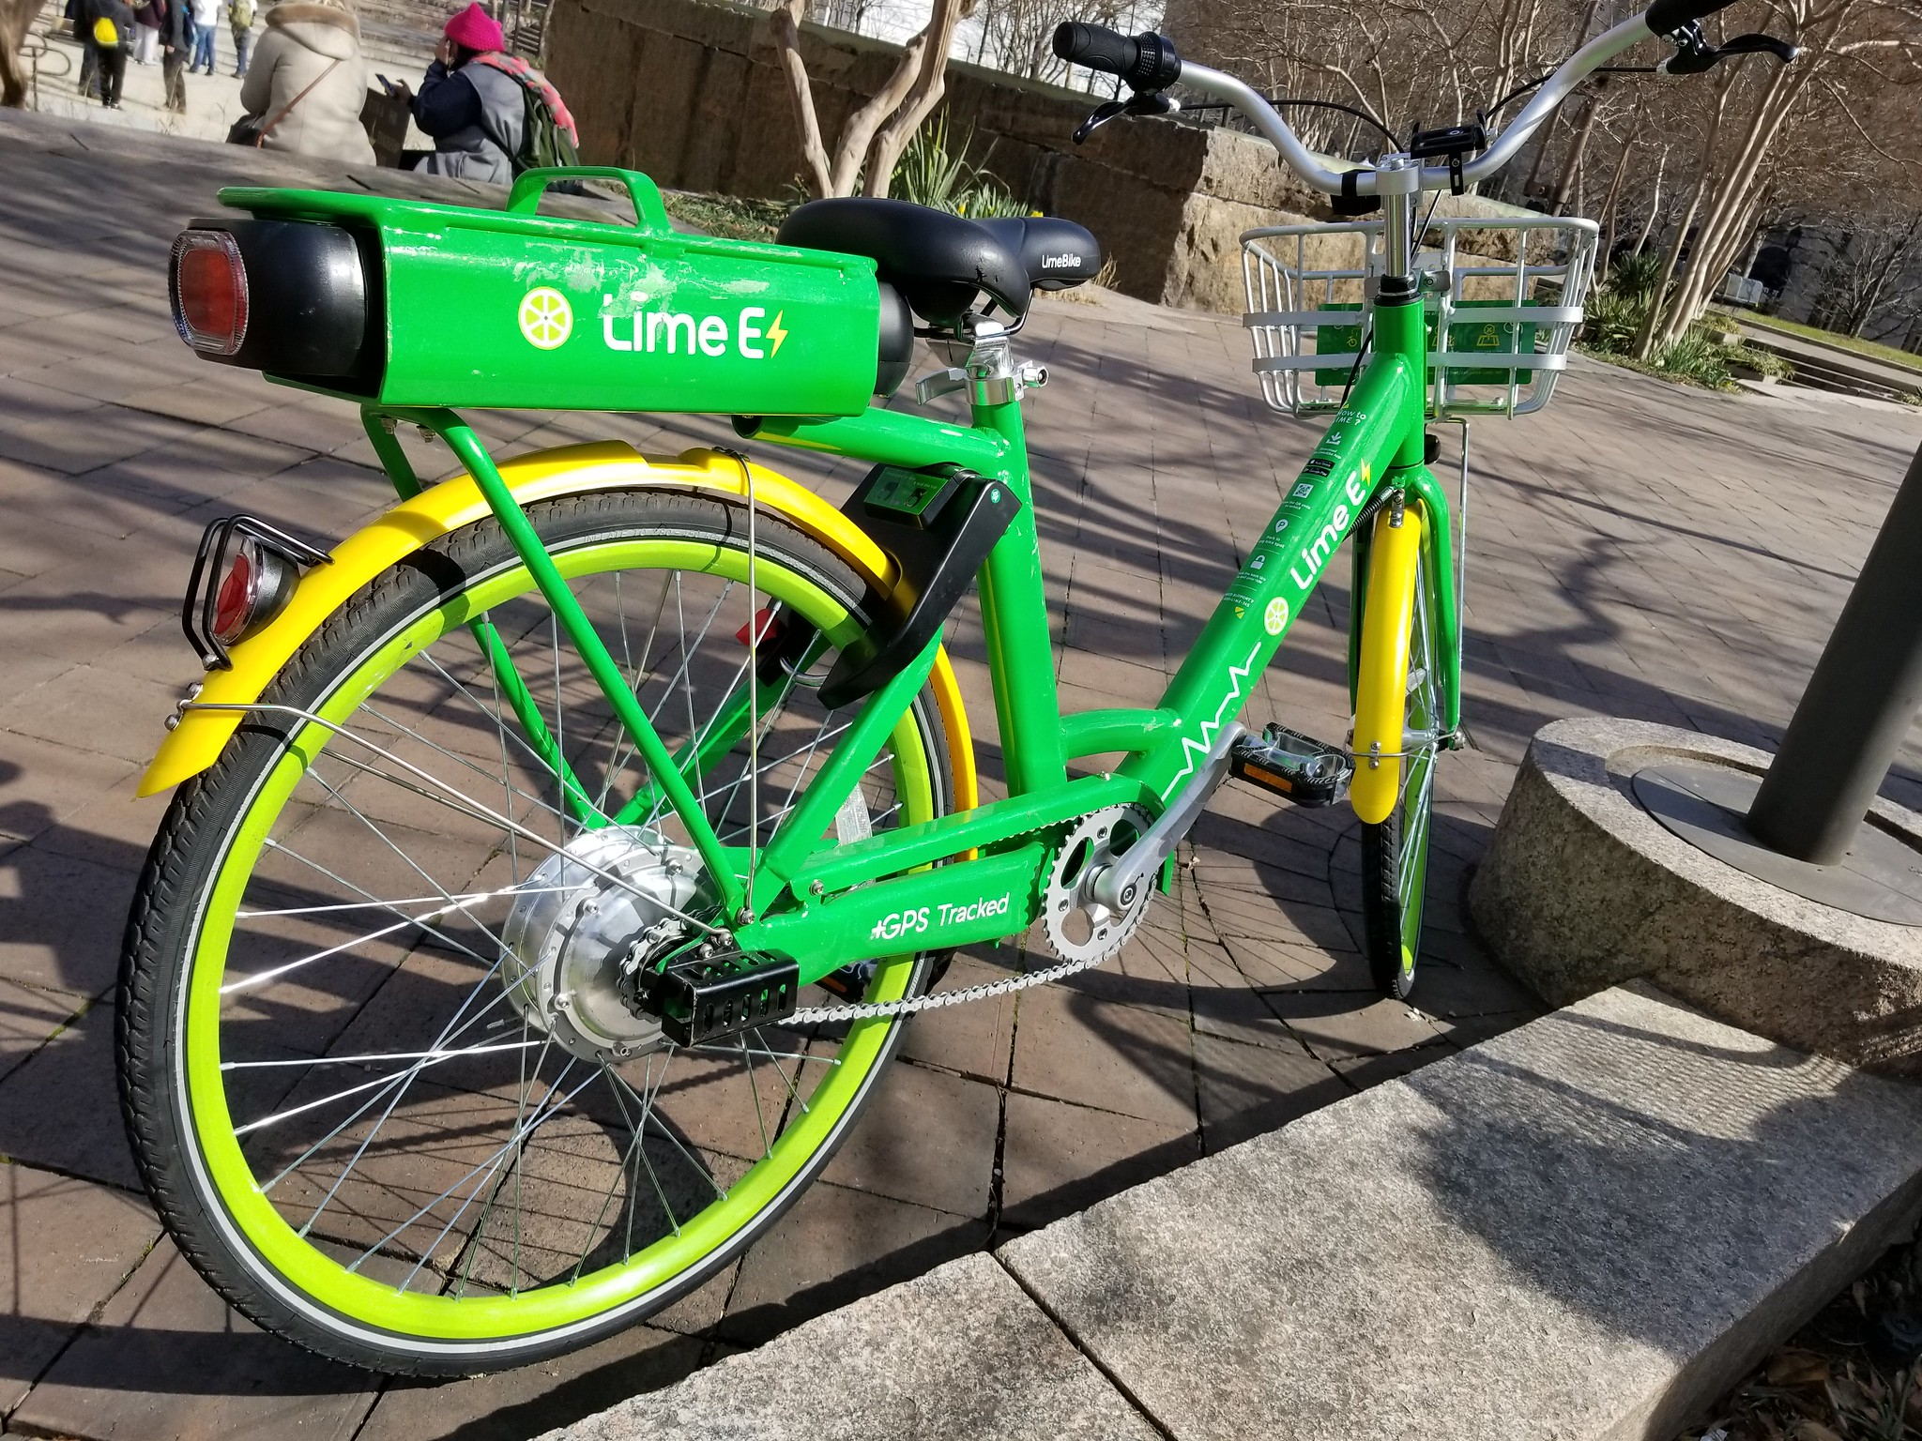
AI as Electric Bike?

Slide 29
Table Discussion
Think of three learning objectives in a course you teach…
One that you’ll KEEP, no matter what AI tools can do.
One that you’re happy to DITCH, thanks to AI tools getting it done.
One that you’ll EXPLORE using AI tools to achieve.
Discuss at your tables and use the Google Sheet to report some of your thoughts.
Notes:
Google Sheet: https://docs.google.com/spreadsheets/d/1oDRU-qrMki2ESHYY0qrSHdZP-nQdOVjT3aUnWU0umsU/edit?usp=sharing

Slide 30

Report out here:
https://is.gd/valpoFFAI

Slide 31
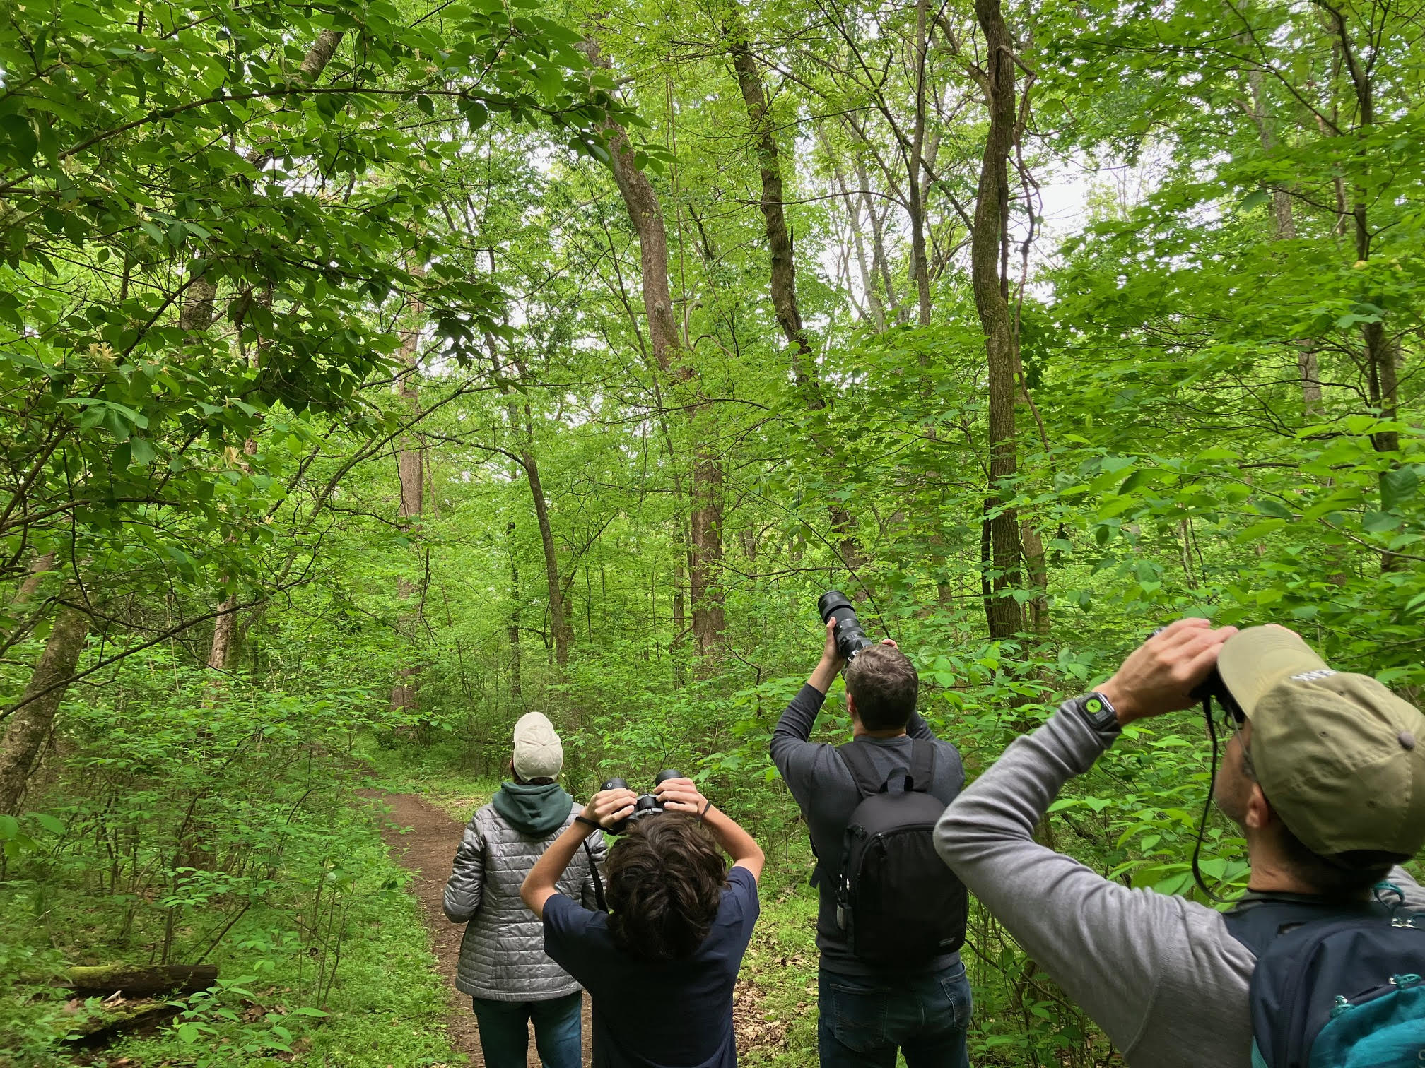
How might we use AI tools to enhance student learning, even toward traditional goals?

Slide 32
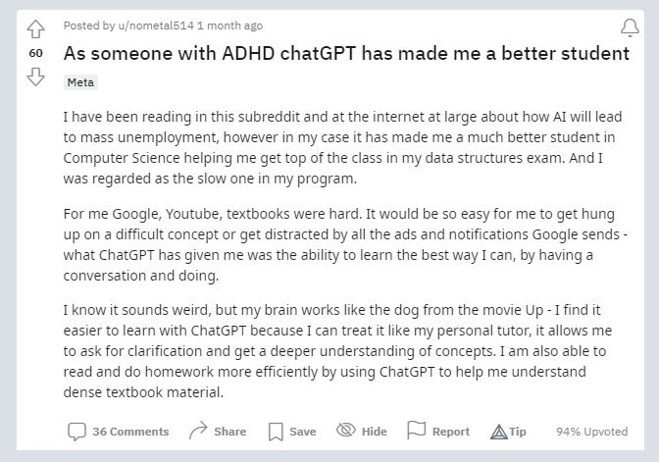
AI can help students face the blank page.
Notes:
https://www.reddit.com/r/OpenAI/comments/103q6vf/as_someone_with_adhd_chatgpt_has_made_me_a_better/

Slide 33
AI can help with idea generation.
“Noting the ‘similarity between my writing and the predicted text,’ a student shared that ‘I felt like I was reading potential sentences that I would have written in another timeline, like I was glancing into multiple futures.’”
Paul Fyfe, North Carolina State University
Notes:
https://link.springer.com/article/10.1007/s00146-022-01397-z

Slide 34
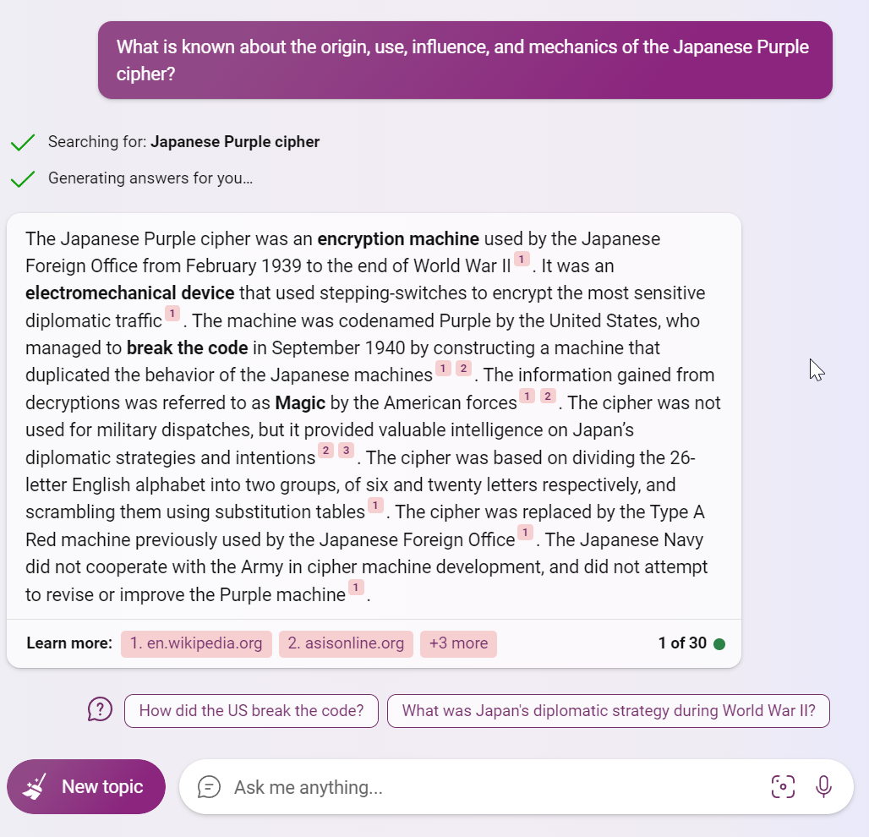

AI can help students explore a topic.

Slide 35
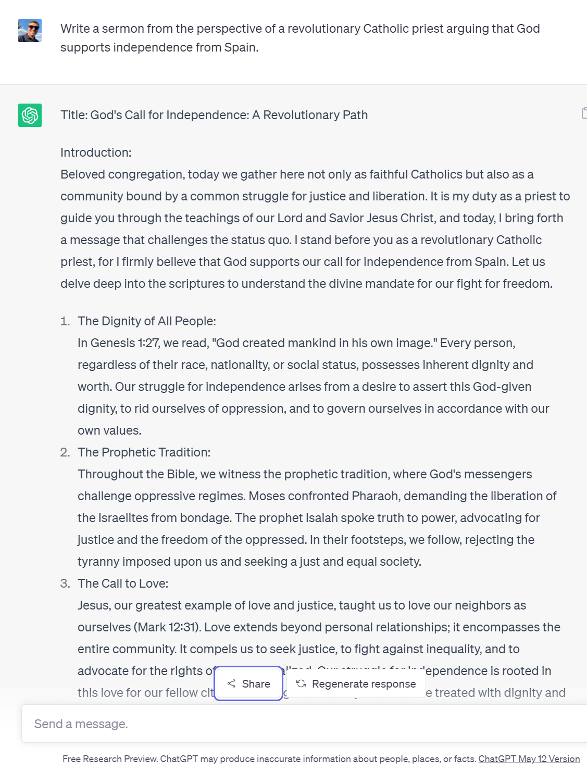
AI can provide examples to critique.
“Write a sermon from the perspective of a revolutionary Catholic priest arguing that God supports independence from Spain.”
“Write a sermon by Jarena Lee explaining why she as a woman would be permitted to preach.”
Tisa Wenger & Erika Helgen,
Yale Divinity School
More info: https://ckarchive.com/b/r8u8hoh20mm5l
Notes:
https://sharegpt.com/c/jj3Y4hm

Slide 36
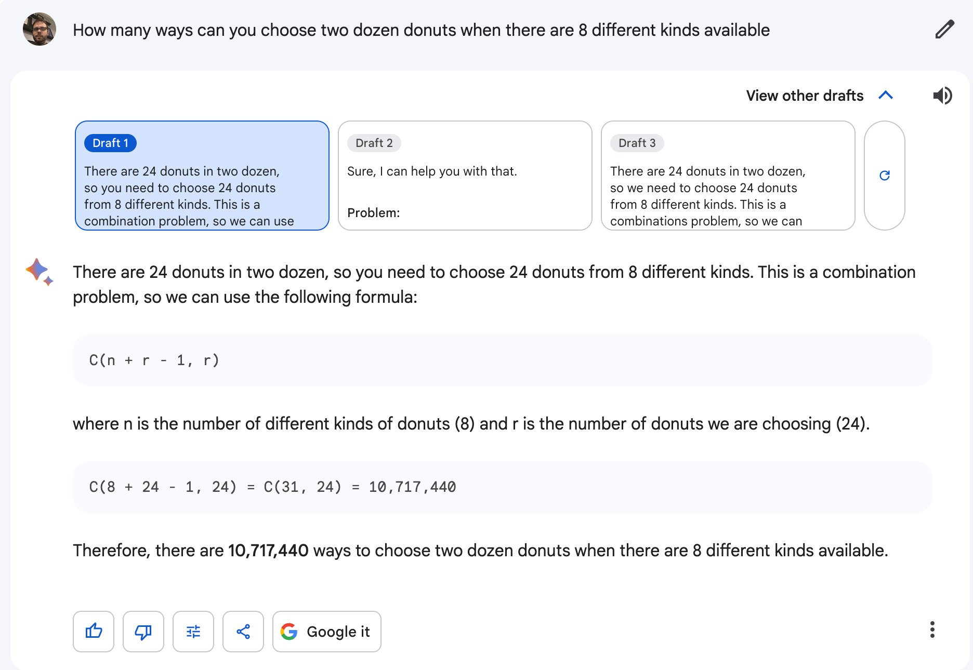
Notes:
https://twitter.com/RobertTalbert/status/1679489007837925380

Slide 37
AI isn’t always worth the effort.
“Once you talk to students about the limitations/benefits of using generative AI, a good number of them tap out and say no thanks.
Many students don’t want to deal with the specter of wielding a tool that [hallucinates] content. Several students expressed how anxiety inducing it is to have to carefully read and factcheck a convincing output generated by a supercomputer.”
Marc Watkins, U. Mississippi, April 2023
Notes:
https://marcwatkins.org/2023/04/15/from-panic-to-reality-how-generative-ai-is-actually-impacting-student-writing/

Slide 38
Table Discussion
At your tables, share your ideas (good, bad, or ugly) about using AI tools to enhance your students’ learning.
In the Google Sheet, report at least one interesting idea and at least one concern or question.

Slide 39
Report out here:
https://is.gd/valpoFFAI

Slide 40

Break!

Slide 41
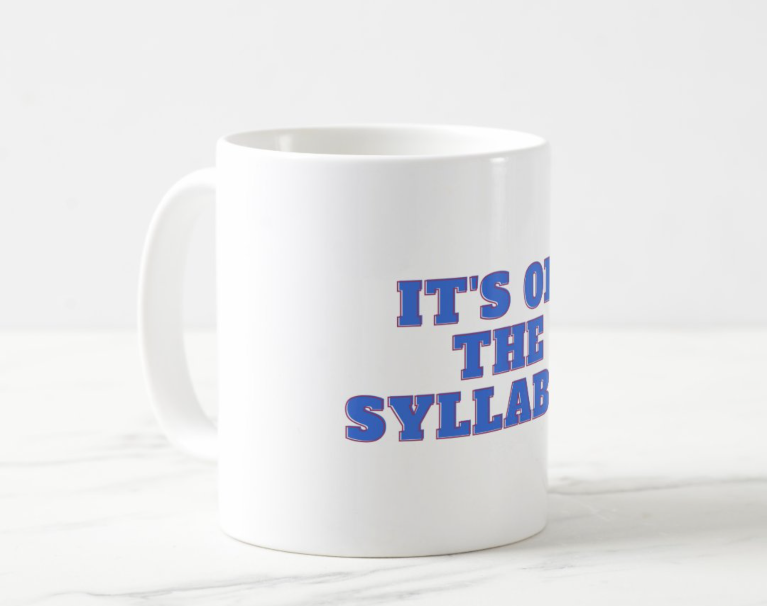



Slide 42
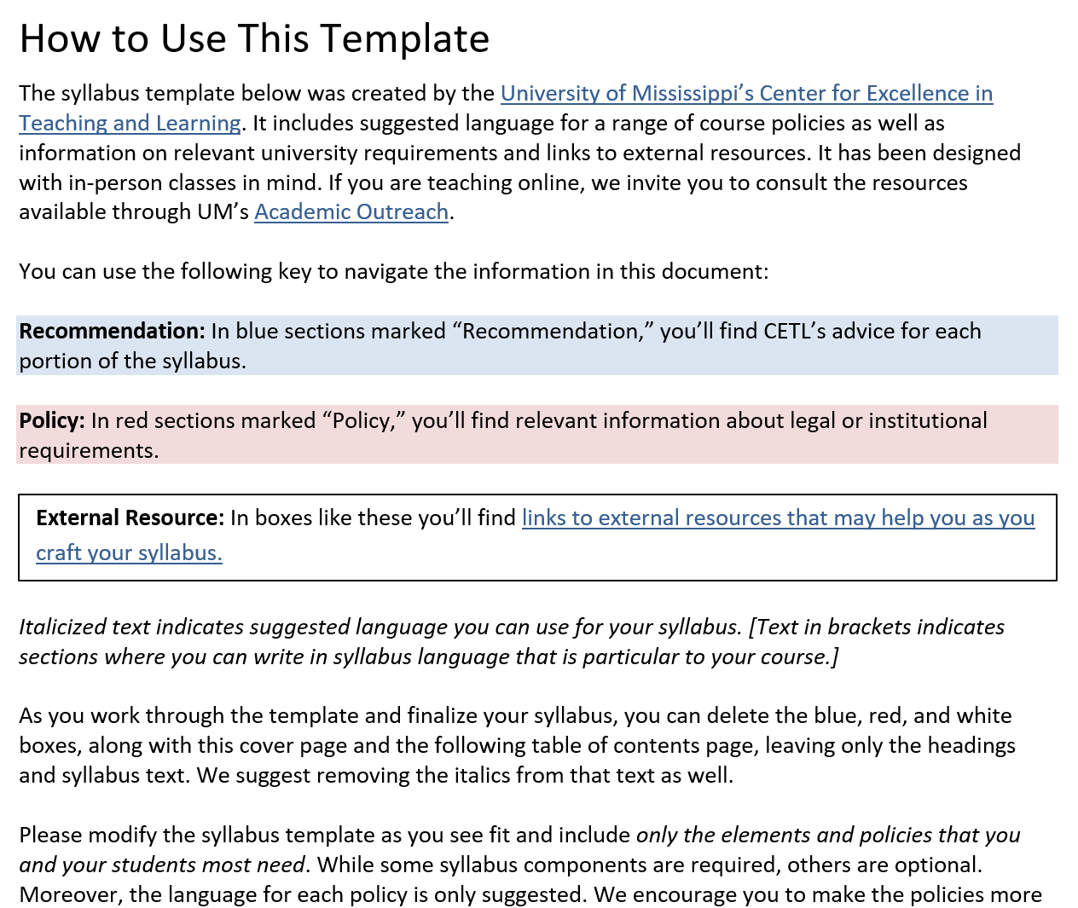
Notes:
https://cetl.olemiss.edu/2023/08/15/policies-and-practices-for-generative-ai-in-fall-courses/

Slide 43
Use of Generative AI Not Permitted
In this course, we’ll be developing skills that are important to practice on your own. Because use of generative AI may inhibit the development of those skills, I ask that you refrain from employing AI tools in this course.
Using such tools for any purposes or attempting to pass off AI-generated work as your own, will violate our academic integrity policy. I treat potential academic integrity violations by [...]
If you’re unsure about whether or not a specific tool makes use of AI or is permitted for use on assignments in this course, please contact me.

Slide 44
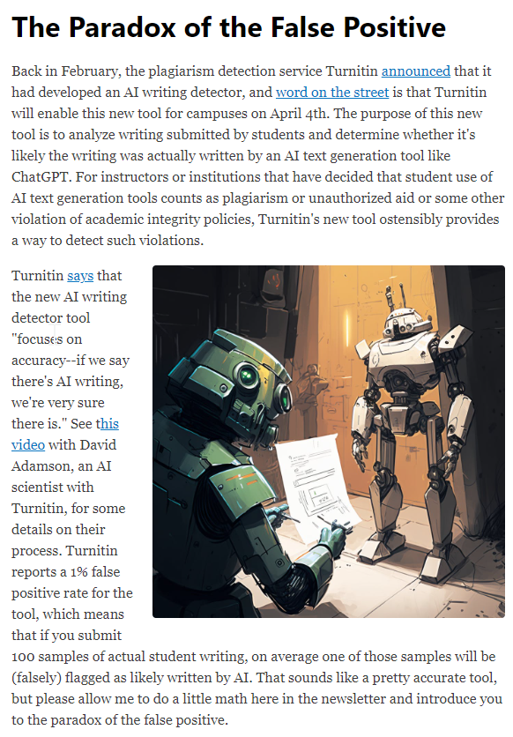
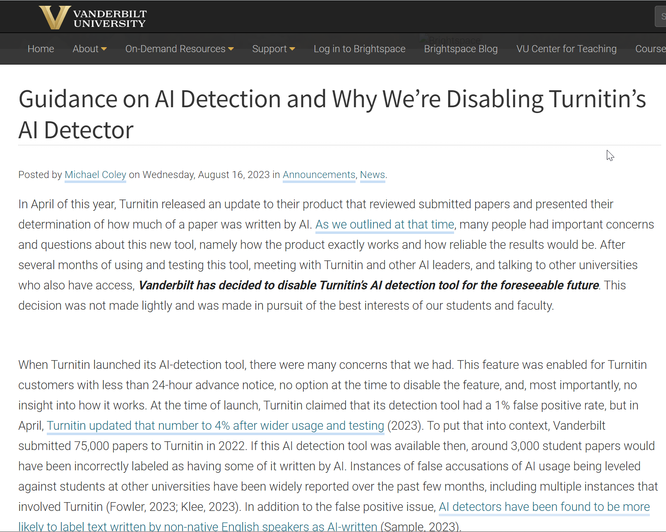
AI Detectors
Notes:
https://ckarchive.com/b/zlughnh4oe0qzhph2nm5g00
https://www.vanderbilt.edu/brightspace/2023/08/16/guidance-on-ai-detection-and-why-were-disabling-turnitins-ai-detector/

Slide 45
Use of Generative AI Permitted
(with or without limitations)

Slide 46
Helping and hindering
AI can support your learning in this course by…
Helping you brainstorm assignment topics or approaches
Helping you consider points of view that hadn’t occurred to you
Generating images for use in presentations
[Or something else]
AI can hinder your learning by…
Generating ideas for you before you have had a chance to think of your own ideas
Inhibiting the development of your own writing skills
Generating factually inaccurate statements or fictional reference sources
[Or something else]

Slide 47
Tools to use (or not)
You may [or may not] use the following tools:
ChatGPT
Google Bard
Bing Chat
Claude
DALL-E
Midjourney
Fermat
Elicit
Grammarly
[Or something else]

Slide 48
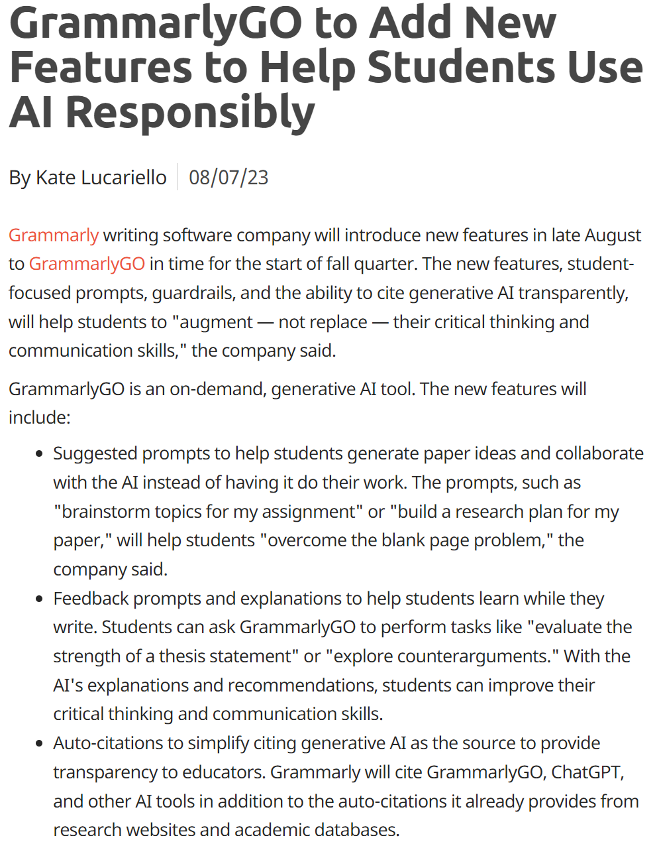
Notes:
https://campustechnology.com/articles/2023/08/07/grammarlygo-to-add-new-features-to-help-students-use-ai-responsibly.aspx?s=ct_nu_100823

Slide 49
Specific uses of tools
You may [or may not] use AI tools in the following ways:
For brainstorming or idea generation
For locating possible sources
For generating counterarguments
For getting feedback on your work
For editing and proofreading
For summarizing readings
For writing computer code
For generating images for presentations
For checking your work on problem sets
[Or something else]

Slide 50
Transparency
If you use an AI tool to complete an assignment, please disclose your use of it by…
Citing the tool
Identifying which elements of the assignment were created using generative AI
Noting how you used the tool
Writing a brief reflection on how AI affected your process
[Or something else]

Slide 51
Red Light / Yellow Light / Green Light
How would you describe your policies toward generative AI in your courses this fall?
Red light – I’ll prohibit the use of AI.
Yellow light – I’ll permit the use of AI, but with limitations.
Green light – Let’s see what AI can do!
No light – I’m not sure yet.

Slide 52
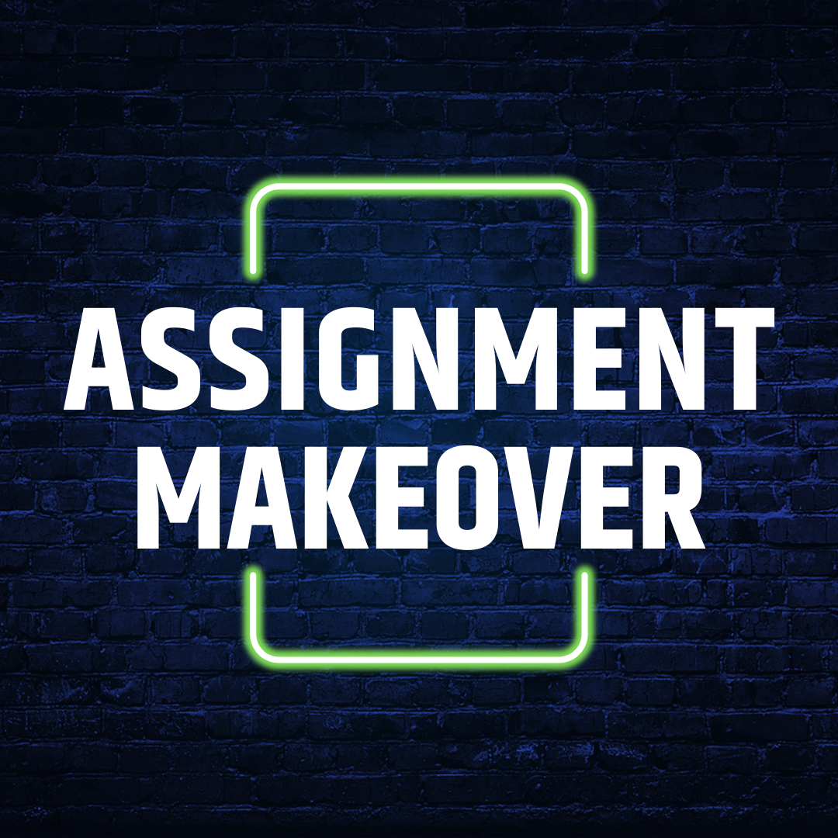
We might need to revise some assignments in light of new AI tools.

Slide 53
Expository Essay
In this paper, you’ll describe the origin, use, influence, and mechanics of a code or cipher of your choice. There are many codes and ciphers we won’t have time to explore in this course. This assignment will provide you a chance to explore a piece of the history of cryptography that interests you personally and to share that exploration with an authentic audience. Your “paper” will take the form of a blog post between 1,000 and 1,500 words that will be submitted for publication on the blog Wonders & Marvels, a history blog edited by Vanderbilt prof Holly Tucker.
You’ll need to adopt a writing voice appropriate to Wonders & Marvels, interest your audience in your chosen code or cipher, and explain the mechanics of your code or cipher (enciphering, deciphering, decryption) in ways your audience can understand. The technical side of your post is the closest you’ll come to the kind of writing that mathematicians do, so be sure to be clear, precise, and concise. This assignment will require some research on your part, and you’ll need to cite your sources in your blog post.

Slide 54
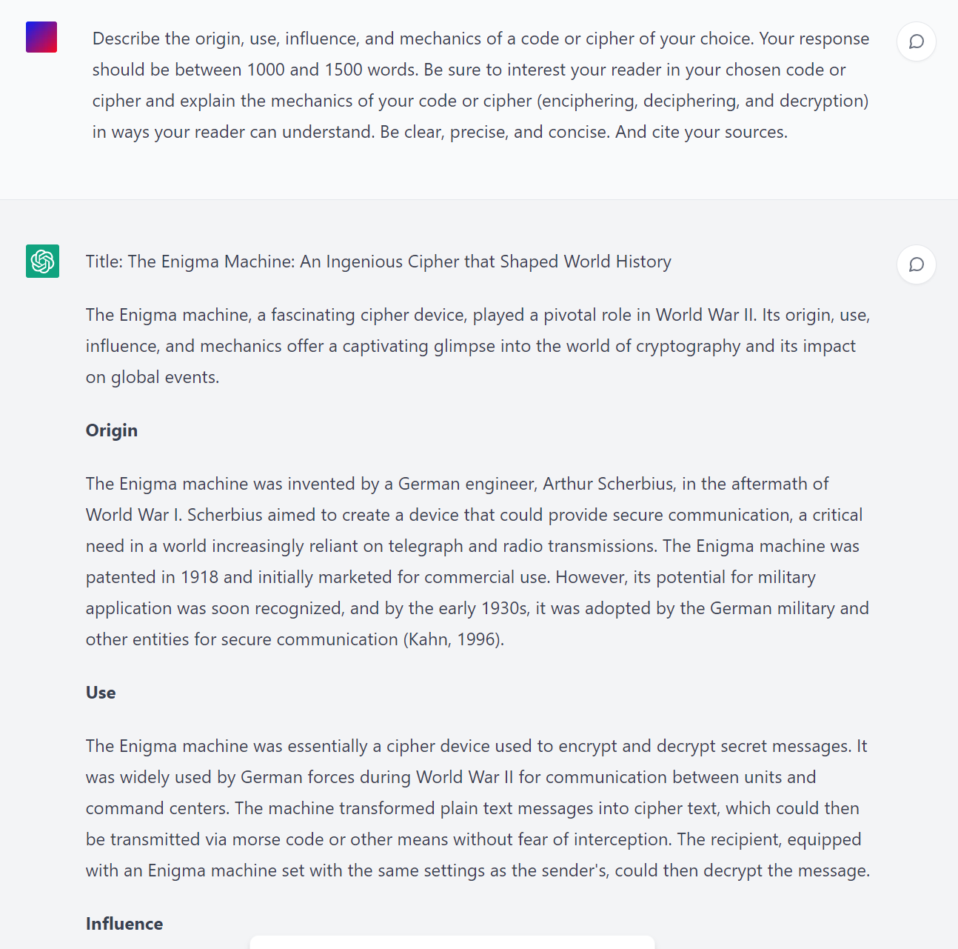
How might students use AI tools while working on this assignment?
Notes:
https://chat.openai.com/c/bee98b84-3af6-4f17-8304-469e89242f60
Back-up: https://sharegpt.com/c/sXPLbQ3

Slide 55
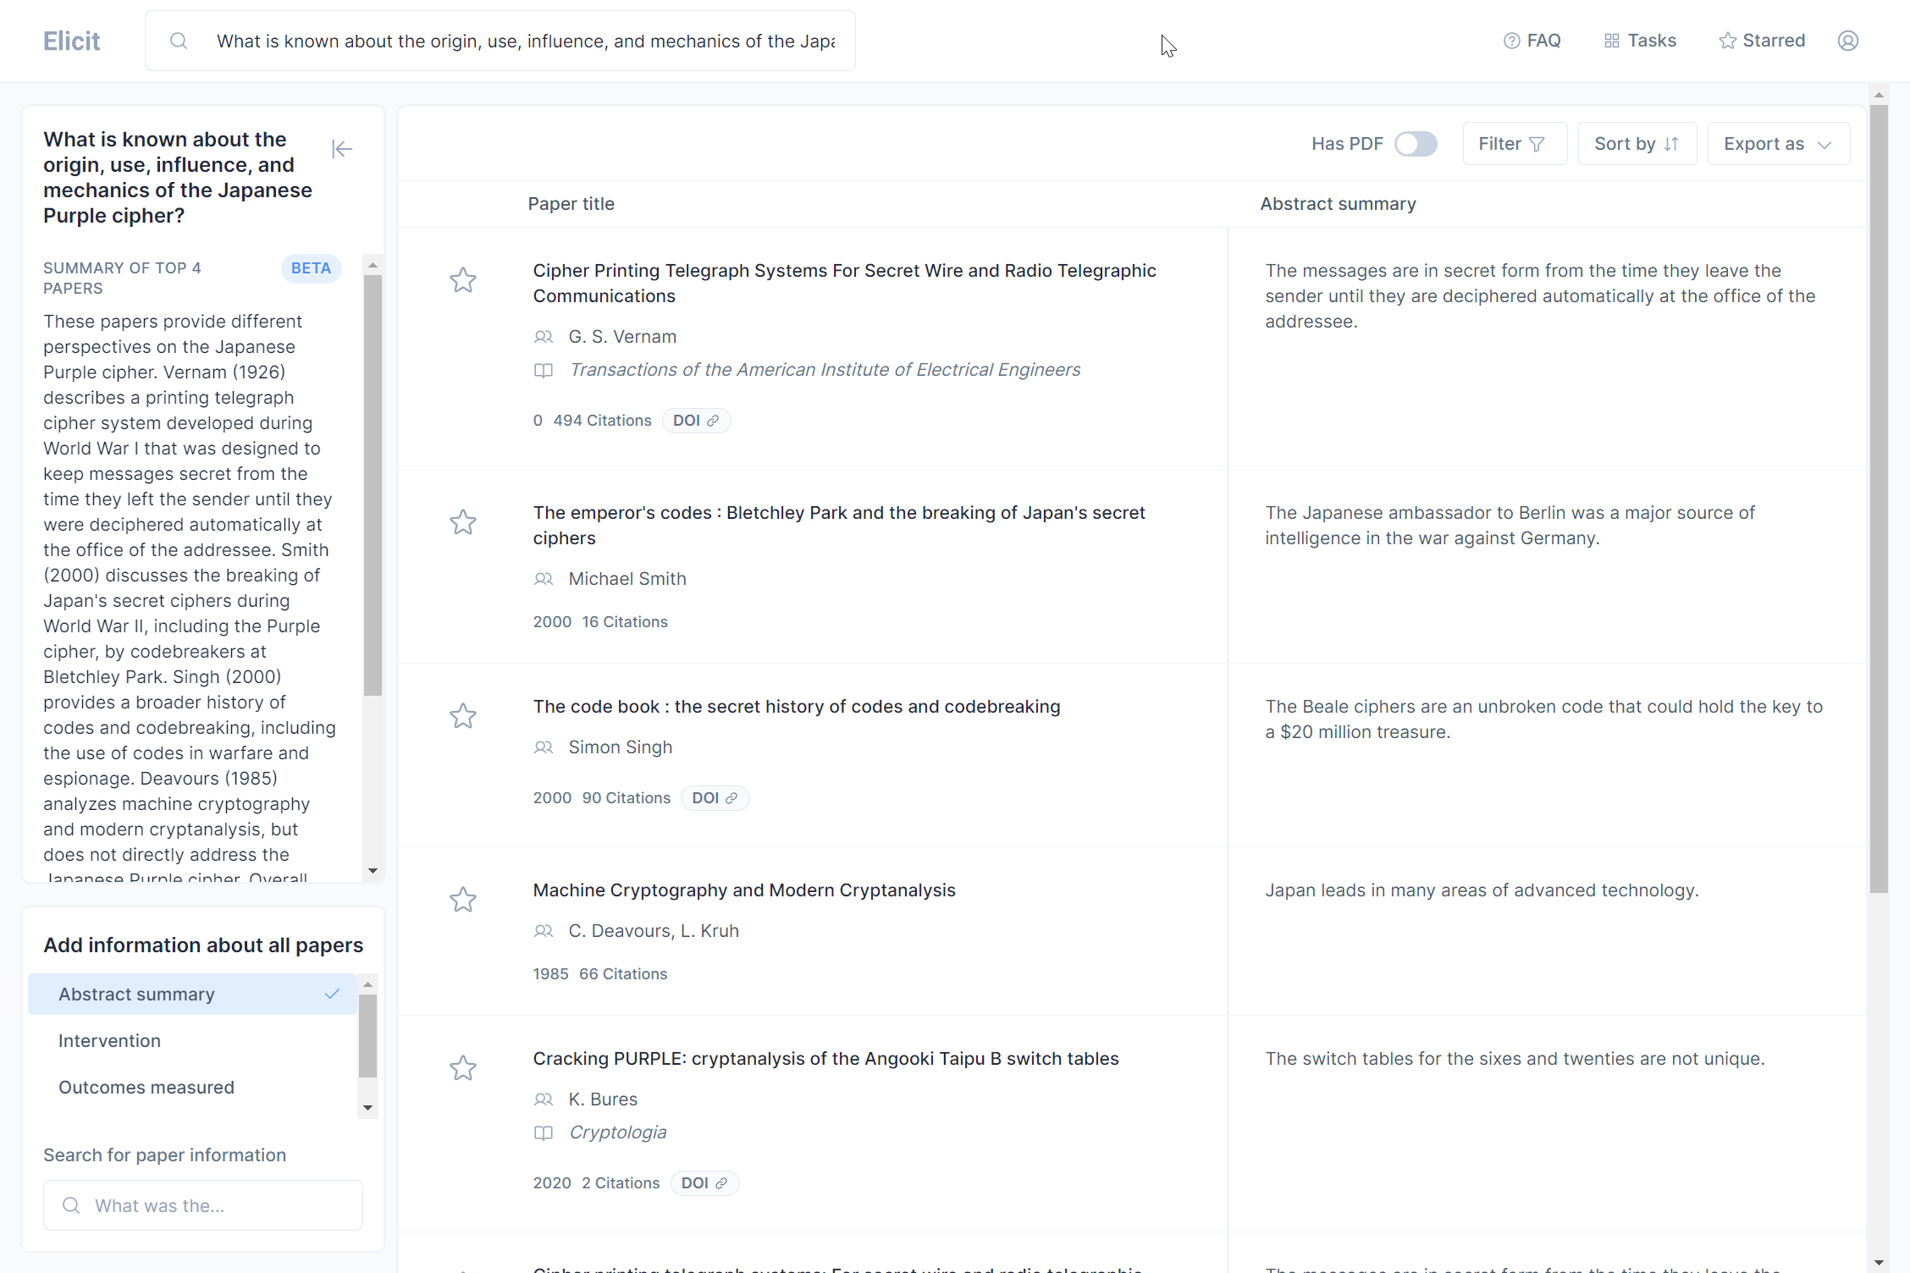
Notes:
https://elicit.org/search?q=What+is+known+about+the+origin%2C+use%2C+influence%2C+and+mechanics+of+the+Japanese+Purple+cipher%3F&token=01H5JZEASA9GB9MMQP38CMJ1TM

Slide 56
Notes:
Bing AI
Other questions Bing suggested: What was the impact of breaking Purple? How did Genevieve Grotjan break Purple? How did the Japanese react to the breaking of Purple?

Slide 57
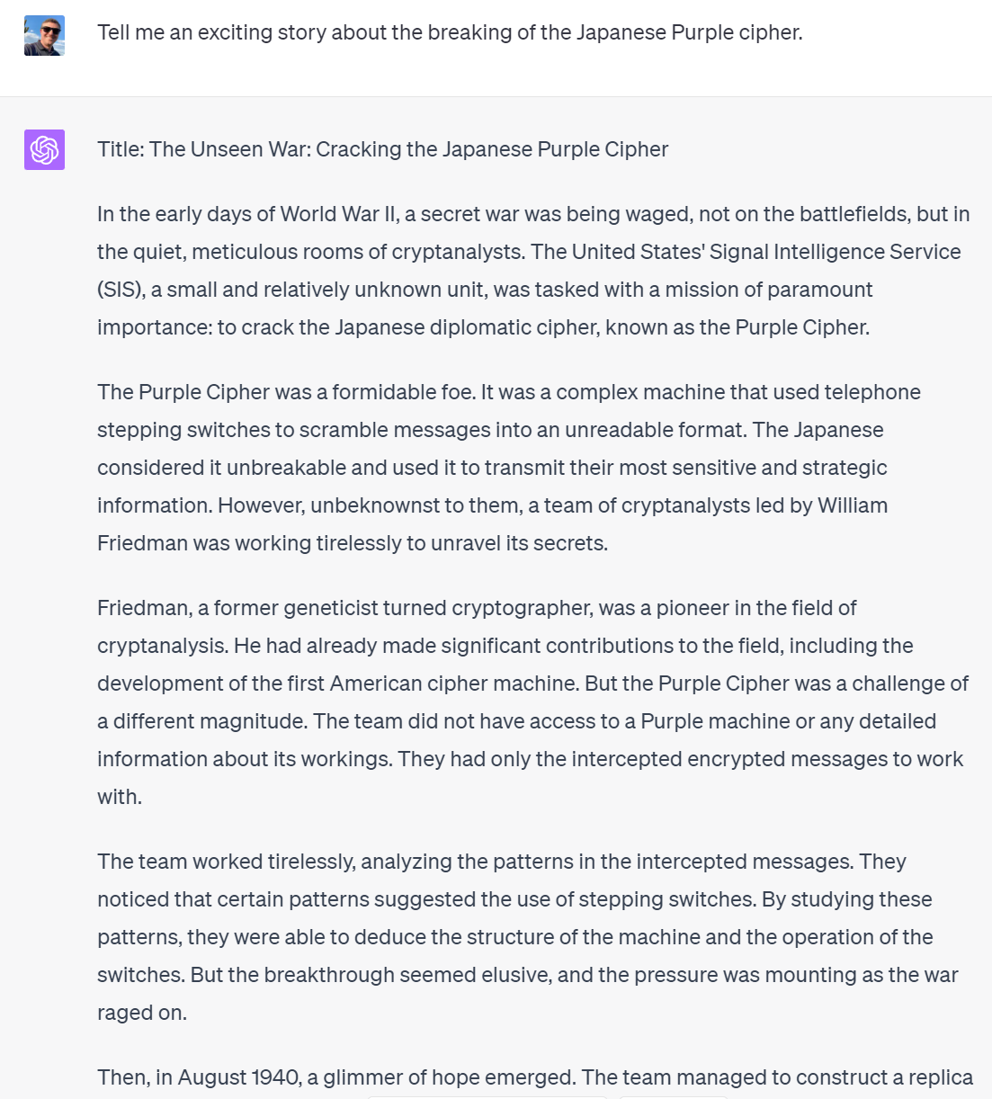

Slide 58
My Makeover Decisions
Decide to teach writing with AI.
As a class activity, collaboratively evaluate a ChatGPT essay draft.
Spend class time on structured peer review.
Use AI source suggestions to teach about working with sources.
Ask students to document and reflect on their use of AI.
Revise the rubric to avoid allocating points to work that’s now too easy.

Slide 59
Assignment Makeover
What’s the assignment? Why does it make sense for this course?
What are specific learning objectives for the assignment?
How might students use AI tools while working on the assignment? (This might take some experiments!)
How might AI undercut the goals of the assignment? How could you mitigate this?
How might AI enhance the assignment? Where would students need help figuring that out?
Focus on the process. How could you make the assignment more meaningful for students? Or support them more in the work?
Notes:
Questions 1 and 2 will need to be answered by the owner of the assignment (maybe me, if we’re using my assignments).
Questions 3 through 6 could involve everyone on the call.

Slide 60
Table Discussion
At your tables, identify an assignment that someone at your table might want to “makeover.”
Investigate how AI tools might be used for that assignment, then suggest ways to alter the assignment.

Slide 61
Questions? There are so many…

Slide 62
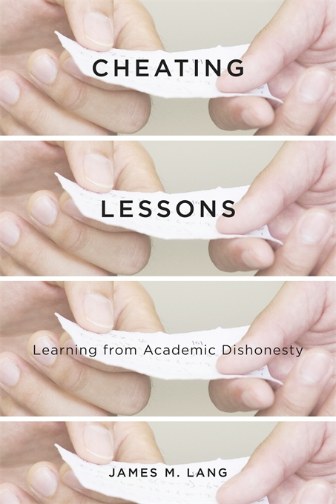
Factors of learning environments that may pressure students into cheating:
An emphasis on performance
High stakes riding on the outcome
An extrinsic motivation for success
A low expectation of success

Slide 63
Creating learning environments that reduce the motivation to cheat:
Fostering intrinsic motivation
Learning for mastery
Lowering stakes
Instilling self-efficacy

Slide 64
Focus on the process.
Assign student work that is as interesting and meaningful to students as possible.
Communicate what makes the process of doing the work valuable.
Provide students the support they need in doing the work.
Focus on building relationships with students as a way to help them stay engaged.
Anna Mills, California Community Colleges, March 2023
Notes:
https://www.chronicle.com/article/chatgpt-just-got-better-what-does-that-mean-for-our-writing-assignments

Slide 65
Looking Ahead
“But we will also need to devise new kinds of questions for advanced students—questions that are hard to answer even with AI assistance, because no one knows what the answer is yet…
These are assignments of a more demanding kind than we have typically handed undergrads, but that’s the point. Some things are actually easier now, and colleges may have to stretch students further in order to challenge them.”
Ted Underwood
Notes:
https://tedunderwood.com/2023/07/31/we-can-save-what-matters-about-writing-at-a-price/

Slide 66
Teaching and Learning in the Age of Generative AI
(The Good, the Bad, the Ugly)
Derek Bruff, PhD,
Center for Excellence in Teaching and Learning,
University of Mississippi
Slides:

Slide 67
Reserve slides

Slide 68
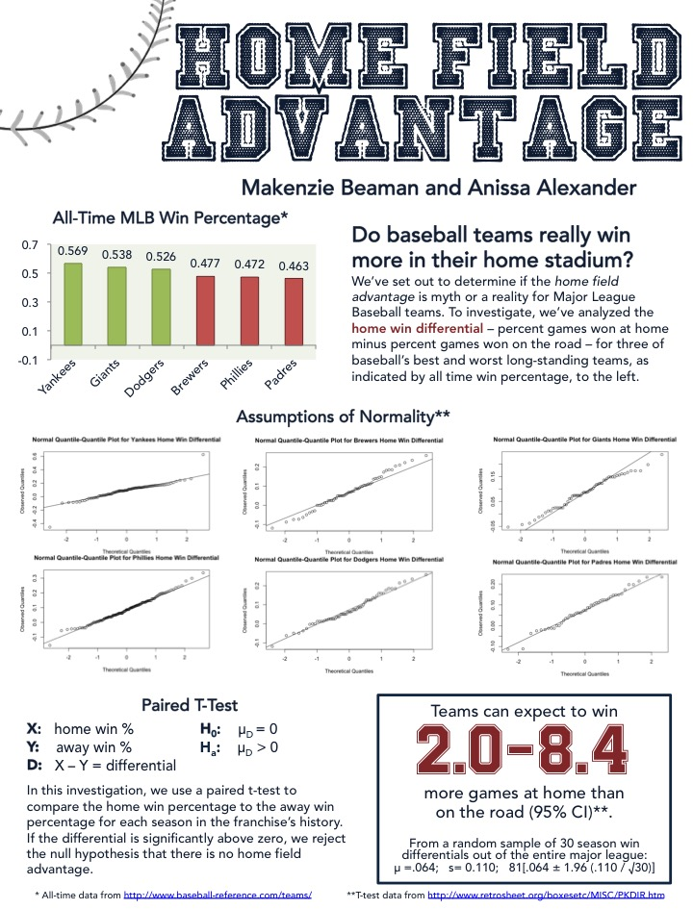
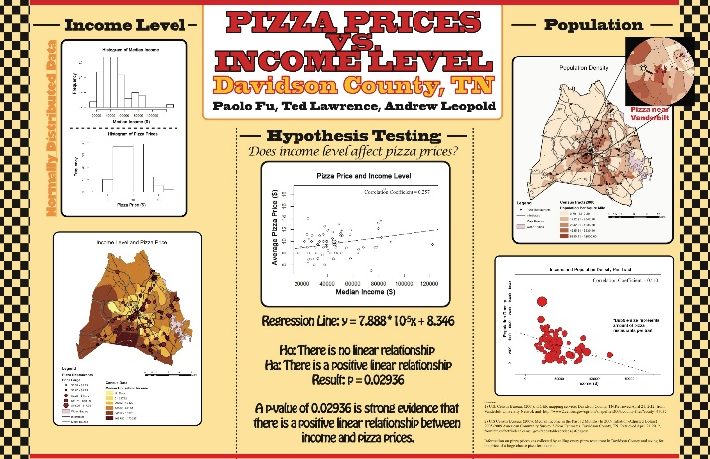
Infographics

Slide 69
Infographic Learning Objectives
Determine an appropriate research question.
  Brainstorm possible research questions.
  Draw on personal interests or prior experiences.
  Assess a question’s feasibility for this project.
  Work with partners to select a research question.
Work with potentially messy data.
  Determine appropriate kinds of data for this question.
  Obtain data from multiple (non-textbook) sources.
  Vet gathered data for usability.
  Spot project roadblocks that would require backtracking.
Apply statistical techniques correctly.
  Determine appropriate techniques for the available data.
  Determine assumptions that need to be tested.
  Compute p-values, given a well-structured set of data.
  Interpret results of statistical techniques in the problem context.
Visualize and communication results.
  Identify relevant visualization techniques.
  Evaluate potential visualization options for meaning and appeal.
  Organize visuals and text into a coherent whole.
  Build infographic using graphic design software.

Slide 70
Infographic Learning Objectives
Determine an appropriate research question.
  Brainstorm possible research questions.
  Draw on personal interests or prior experiences.
  Assess a question’s feasibility for this project.
  Work with partners to select a research question.
Work with potentially messy data.
  Determine appropriate kinds of data for this question.
  Obtain data from multiple (non-textbook) sources.
  Vet gathered data for usability.
  Spot project roadblocks that would require backtracking.
Apply statistical techniques correctly.
  Determine appropriate techniques for the available data.
  Determine assumptions that need to be tested.
  Compute p-values, given a well-structured set of data.
  Interpret results of statistical techniques in the problem context.
Visualize and communication results.
  Identify relevant visualization techniques.
  Evaluate potential visualization options for meaning and appeal.
  Organize visuals and text into a coherent whole.
  Build infographic using graphic design software.

Slide 71
ChatGPT can visualize data for you.
Notes:
https://chat.openai.com/share/dfbd19f5-2348-4038-a8ae-63d89b8f271a
See also https://the-decoder.com/openai-launches-chatgpt-code-interpreter-for-better-coding-using-only-natural-language/

Slide 72
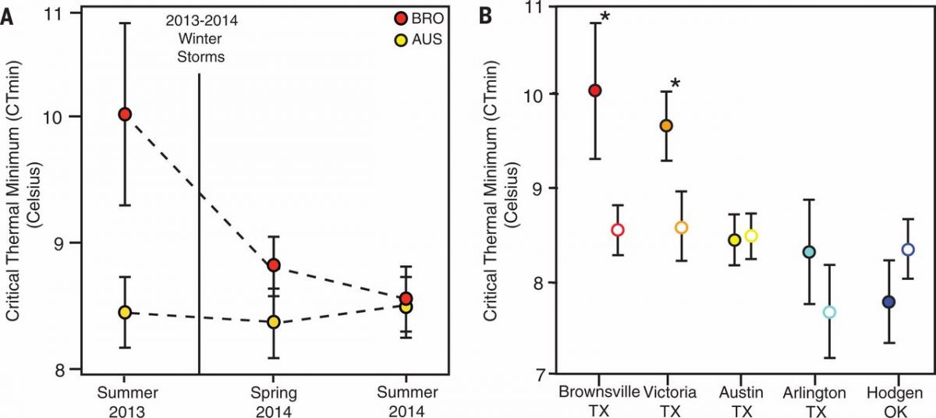
Google Bard can analyze data visualizations for you.
Notes:
https://www.biointeractive.org/classroom-resources/lizards-cold

Slide 73
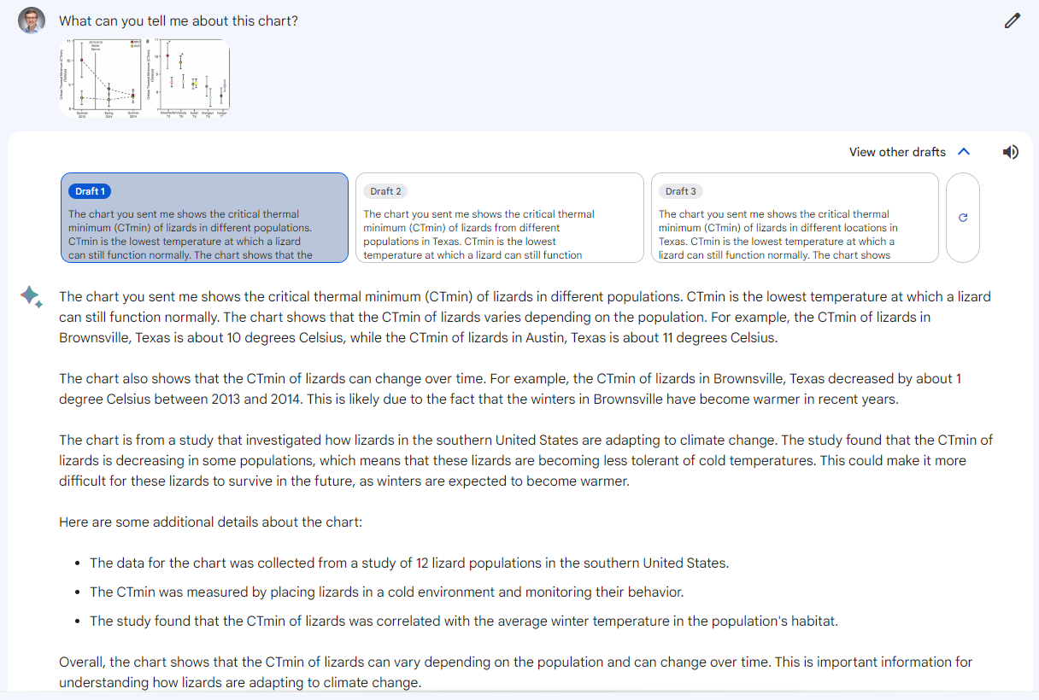
Notes:
https://www.biointeractive.org/classroom-resources/lizards-cold
https://g.co/bard/share/301bb3f087aa

Slide 74
Infographic Learning Objectives
Determine an appropriate research question.
  Brainstorm possible research questions.
  Draw on personal interests or prior experiences.
  Assess a question’s feasibility for this project.
  Work with partners to select a research question.
Work with potentially messy data.
  Determine appropriate kinds of data for this question.
  Obtain data from multiple (non-textbook) sources.
  Vet gathered data for usability.
  Spot project roadblocks that would require backtracking.
Apply statistical techniques correctly.
  Determine appropriate techniques for the available data.
  Determine assumptions that need to be tested.
  Compute p-values, given a well-structured set of data.
  Interpret results of statistical techniques in the problem context.
Visualize and communication results.
  Identify relevant visualization techniques.
  Evaluate potential visualization options for meaning and appeal.
  Organize visuals and text into a coherent whole.
  Build infographic using graphic design software.

Slide 75
My Makeover Decisions
Decide to teach statistics with AI.
Teach the tools through in-class activities and low-stakes assignments.
Use the tools to teach statistics.
Use class time for structured peer review of draft projects.
Ask students to document and reflect on their use of AI.
Revise the rubric to avoid allocating points to work that’s now too easy.

Slide 76

We will need to update our academic integrity norms and policies.
“A professor who encourages the use of Wikipedia is the intellectual equivalent of a dietician who recommends a steady diet of Big Macs with everything.”
Michael Gorman, former president of the American Library Association, June 2007

Slide 77
What uses will be considered ethical?
Based on a survey of 83 students and 82 faculty:
  Least ethical – Use AI to write an entire paper. Look up a concept in Google and copy and paste it.
  Most ethical – Spell check. Citation helper. Grammarly.
  In the middle – Use AI to expand a paper. Use AI but cite it. Use AI to make an outline for a paper.
Hostetter, Call, Frazier, James, Linnertz, Nestle, & Tucci
Psychology, Kalamazoo College
Notes:
https://psyarxiv.com/7dnk9/

Slide 78
How does one cite ChatGPT?
I did not use ChatGPT for this assignment.
ChatGPT helped with grammar and readability, but the original writing was my own.
ChatGPT helped with idea generation, but I wrote the assignment myself.
A small amount of my work (just a couple of sentences) were written by ChatGPT
ChatGPT significantly wrote my work, but I edited it.
Monica Linden, Brown University
Notes:
https://link.springer.com/article/10.1007/s00146-022-01397-z

Slide 79
Academic Norms and Policies
Is ChatGPT a “someone else” whose words can be plagiarized?
If using ChatGPT constitutes unauthorized aid, what about a less generative tool like Grammarly? Or Microsoft Word’s spellchecker?
If you require students to cite their use of ChatGPT, how does one cite an AI text generation tool?
How can we communicate new academic integrity norms to students?
What unit policies can we make that respect the different roles these tools might play in different courses?

Slide 80

Other communities are updating their norms and policies, too.
“First, no LLM tool will be accepted as a credited author on a research paper. That is because any attribution of authorship carries with it accountability for the work, and AI tools cannot take such responsibility.
“Second, researchers using LLM tools should document this use in the methods or acknowledgements sections. If a paper does not include these sections, the introduction or another appropriate section can be used to document the use of the LLM.”
Notes:
https://www.nature.com/articles/d41586-023-00191-1
See also https://www.wired.com/about/generative-ai-policy/

Slide 81

Other communities are updating their norms and policies, too.
“The justices turned away Thaler's appeal of a lower court's ruling that patents can be issued only to human inventors and that his AI system could not be considered the legal creator of two inventions that he has said it generated.”
Notes:
https://www.reuters.com/legal/us-supreme-court-rejects-computer-scientists-lawsuit-over-ai-generated-2023-04-24/

Slide 82

Students will complain, too.
“Disgusting… Lead us into a better future with genuine, human empathy, not a robot.”
“In times of tragedies such as this, we need more, not less humanity.”
“Using ChatGPT is presumed to be cheating in academic settings.”
– Vanderbilt students
Notes:
https://vanderbilthustler.com/2023/02/17/peabody-edi-office-responds-to-msu-shooting-with-email-written-using-chatgpt/
Update: The leaders of that office have “temporarily stepped back.”
Seriously?
These emails are largely boilerplate anyway. Why use ChatGPT?
The administrators actually cited their use of ChatGPT in the email. That’s good academic form, right? No, in this case, it made it clear that the email was actually boilerplate.
Students are having a very similar reaction here that faculty had in December when students started using ChatGPT for assignments.
That last student is actually wrong. There’s no blanket policy at Vanderbilt; it’s up to individual faculty to define “unauthorized aid.”

Slide 83

Her (2013)

Slide 84
Random Walks aka Markov models
Training text:
Would you, could you in a house
Would you, could you with a mouse
Would you, could you in a box
Would you, could you with a fox
Would you like green eggs and ham?
Would you like them, Sam I Am?
Transitions:
would -> you (100%)
you -> could (40%), like (20%), in (20%), with (20%)
could -> you (100%)
like -> green (50%), them (50%)
... and so forth ...
Random Walk:
Would you in a fox? Could you like green eggs.

Slide 85
Random Walks
Training text:
Would you, could you in a house
Would you, could you with a mouse
Would you, could you in a box
Would you, could you with a fox
Would you like green eggs and ham?
Would you like them, Sam I Am?
Transitions:
would -> you (100%)
you -> could (40%), like (20%), in (20%), with (20%)
could -> you (100%)
like -> green (50%), them (50%)
... and so forth ...
Random Walk:
Would you in a fox? Could you like green eggs.

Slide 86
Random Walks
Training text:
Would you, could you in a house
Would you, could you with a mouse
Would you, could you in a box
Would you, could you with a fox
Would you like green eggs and ham?
Would you like them, Sam I Am?
Transitions:
would -> you (100%)
you -> could (40%), like (20%), in (20%), with (20%)
could -> you (100%)
like -> green (50%), them (50%)
... and so forth ...
Random Walk:
Would you in a fox? Could you like green eggs.

Slide 87
Random Walks
Training text:
Would you, could you in a house
Would you, could you with a mouse
Would you, could you in a box
Would you, could you with a fox
Would you like green eggs and ham?
Would you like them, Sam I Am?
Transitions:
would -> you (100%)
you -> could (40%), like (20%), in (20%), with (20%)
could -> you (100%)
like -> green (50%), them (50%)
... and so forth ...
Random Walk:
Would you in a fox? Could you like green eggs.

Slide 88

Markovbots
“The days in which the cultivators even of inferior power. That a country, which has been”

Slide 89
GPT-3 has been trained on 45 terabytes of text data.
Common Crawl 410 billion tokens 60% weight
WebText2 19 billion 22%
Books1 12 billion 8%
Books2 55 billion 8%
Wikipedia 3 billion 3%
Notes:
Common Crawl corpus contains petabytes of data collected over 8 years of web crawling. The corpus contains raw web page data, metadata extracts and text extracts with light filtering.
WebText2 is the text of web pages from all outbound Reddit links from posts with 3+ upvotes.
Books1 & Books2 are two internet-based books corpora.
Wikipedia pages in the English language are also part of the training corpus.
Tokens are pieces of words. One token is approximately 4 characters in English.

Slide 90
Google’s C4 data set, via WaPo
Notes:
https://www.washingtonpost.com/technology/interactive/2023/ai-chatbot-learning/
The interaction version is pretty interesting. And you can look up specific websites to see where they rank.

Slide 91
Large language models
Language models generated text by looking at the “tokens” (parts of words) that came before.
  The ball rolled down the [hill, 95%]
The “T” in GPT stands for “transformer.” This model pays attention to context.
  Paul threw a brick over the river, hitting the bank.
  [It broke a window and the alarm went off.]
  [It landed with a thud in the soft mud.]
Notes:
Examples courtesy Dan Lametti.

Slide 92
Garbage in, garbage out.
“Large-language models… are trained on, among other things, the web, which is to say society’s sooty exhaust, carrying all the errors, mistakes, conspiracies, biases, bigotries, presumptions, and stupidities — as well as genius — of humanity online. When we blame an algorithm for exhibiting bias we should start with the realization that it is reflecting our own biases.”
Jeff Jarvis, CUNY Newmark School of Journalism
Notes:
https://medium.com/whither-news/journalism-is-lossy-compression-86380f0bdb50

Slide 93

Much more information here:
Notes:
https://writings.stephenwolfram.com/2023/02/what-is-chatgpt-doing-and-why-does-it-work/

Slide 94

Notes:
https://chat.openai.com/share/75f43c5c-151b-470d-b142-9c23977f812f

Slide 95

Notes:
https://chat.openai.com/share/75f43c5c-151b-470d-b142-9c23977f812f

Slide 96

Notes:
https://chat.openai.com/share/75f43c5c-151b-470d-b142-9c23977f812f

Slide 97


Slide 98

Computer science is ahead of us.
“Novices using such [tools] … may quickly become accustomed to auto-suggested solutions. This may lead to students not reading problem statements carefully, or at all, and therefore not thinking about the computational steps needed to solve a problem.”
Brett Becker et al. (2022)
Notes:
https://www.brettbecker.com/wp-content/uploads/2022/10/becker2023programming.pdf
GitHub Copilot example by Emery Berger, https://itnext.io/coping-with-copilot-b2b59671e516. All the bolded text was auto-generated.

Slide 99
AI-written computer code
Opportunities
  Quickly generate multiple solutions that vary in technique and style.
  Generate not only code but also easy-to-read explanations of how it works.
  Shift toward an “emphasis in code reading and evaluation rather than code generation.”
Challenges
  “How much content can be machine-generated while still attributing the intellectual ownership to a human?”
  Novices might become reliant on auto-suggested solutions, without reading problem statements carefully.
  AI code generators can produce code that looks correct but doesn’t work as intended. This is a particular challenge for novices.
Notes:
Is AI code generation that much different from existing code completers?

Slide 100

Writing prompts is an art. Or a skill.
Andy Famiglietti, West Chester University
Notes:
https://mastodon.social/@afamiglietti79/109756695917123083

Slide 101

Time to Unbundle?
“It means for those of us who are teachers that we have to unbundle our assessments…
A research paper is doing lots of different things. It’s supporting me to develop my research skills, my [skill at evaluating sources], my writing skills, my revision skills. Maybe there’s a presentation at the end.
I have to think… Which of those parts is really going to help my students develop things that will help them further in life? And maybe the other ones I can recognize, it’s going to be better for them to be able to mastery over this tool.”
James Lang, Intentional Teaching Ep. 13
Notes:
https://intentionalteaching.buzzsprout.com/2069949/12902485-rethinking-teaching-in-an-age-of-ai-with-james-m-lang-and-michelle-d-miller

