Slide 1

Fall Faculty Workshop 2023

Slide 2

Opening Blessing
James Wetzstein
University Pastor

Slide 3
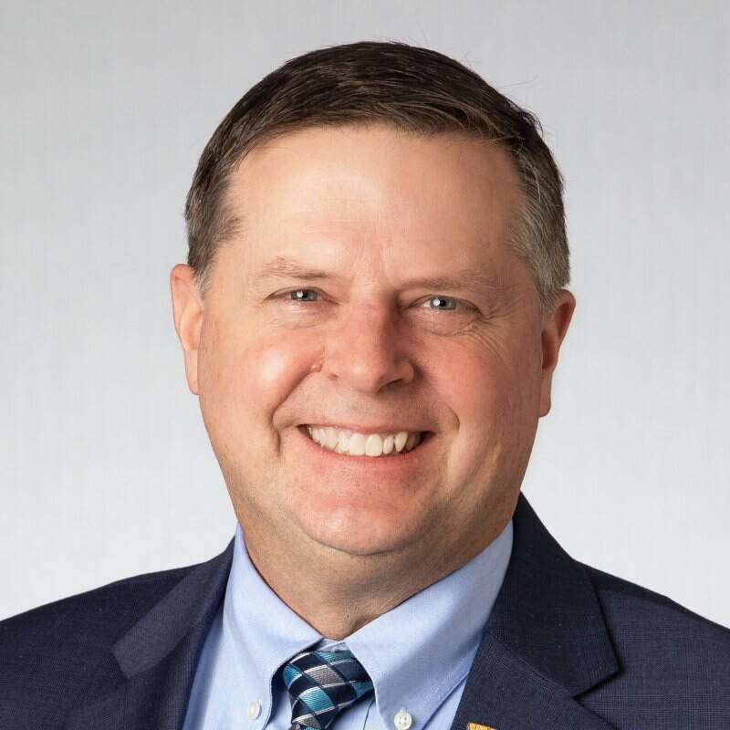
Provost’s Welcome
Eric W. Johnson ‘87, Ph.D.,
Professor of Electrical and Computer Engineering

Slide 4

Overview of Changes to the Honor Council Process
Presented by Members of the Honor Council Executive Committee
This Photo by Unknown Author is licensed under CC BY-NC.

Slide 5



“I have neither given or received, nor have
I tolerated others’ use of unauthorized aid.”
Recent Changes to the Honor System

Slide 6
A Brief History
The establishment of the Honor System was proposed by the student body president in 1943.
Since that time, the Honor Council has maintained its character of being student led.
  Student investigators
  Student-run hearings
Embedded in the Honor System is:
  The assumption of academic honesty and integrity
  The privilege of unproctored exams- request to proctor your exam at: https://www.valpo.edu/honor-council/request-proctor/

Slide 7
What Does it Mean?
To show that they have abided by the Honor Code, students should include the following statement on all their work:
  “I have neither given or received, nor have I tolerated others’ use of unauthorized aid.”
By writing out the Valpo Honor Code, students affirm that they…
  Have not engaged in academic dishonesty
  Have not witnessed others engage in academic dishonesty
  Have not contributed to the academic dishonesty of another student

Slide 8
The Role of Faculty
Requiring students to write out and sign the Honor Code for all work that is turned in for a grade.
Reporting violations and gathering the necessary evidence.
Answering questions that students have about the Honor Code.
Referring students to serve on the Honor Council
Serving on the Honor Council.
Writing syllabi that clearly outline expectations related to the Honor Code.

Slide 9
The Role of Faculty
The Syllabus- each syllabus should contain a statement about the VU Honor Code, including:
  The verbatim text of the Honor Code itself
  VERY SPECIFIC examples of what constitutes authorized and unauthorized aid (included in this presentation but customized to your course requirements)
  Inclusion of a policy on AI
Explaining the Honor Code to students
  First day focal point
  Expectations for each major assignment and test- included in assignment/exam text
  What it means in an online work environment

Slide 10
Honor Council
Honor System is enforced by the Honor Council
  Student organization
  Faculty Senate committee
Overseen by Honor Council Executive Board
  Faculty/Staff: Jon Beagley, Danielle Lavin-Loucks, Cynthia Rutz
  Student: Adam Monnette, Sophie Grube
  Coordinator: Carrie Miller

Slide 11
Reporting a Violation
If you suspect a violation of the honor system has occurred in your class:
  Gather supporting documentation- you will need to include/upload ALL details of the violation and any evidence in your report, including…
    The syllabus for the course
    The assignment/exam/paper in question
    A narrative that clearly indicates the accusation
    The student(s) involved
  Report the alleged offense on the Honor Council website within 7 days of the discovery of the incident
  Continue to carry on with class like normal
  If students report it to you, direct them to the website

Slide 12
The Process
Students are notified of an accusation within 5 days of the report being submitted.
All students are presumed innocent.
Students are presented with all of the evidence against them, taken directly from the initial report, prior to the hearing and will sign a document indicating this.
Students will be asked to enter a plea of responsible or not responsible.

Slide 13
The Process, cont.
Hearings with the accused are conducted via Zoom.
  The accused is requested to attend.
  If they do not attend, they forfeit their right to present a defense.
  The names of students and faculty who report violations are kept confidential, and parties remain separated prior to the hearing.

Slide 14
The Process, cont.
Students enter a plea of responsible or not responsible
  A responsible plea requires no hearing
    Standard penalties apply unless there are mitigating circumstances that warrant a restorative approach
  A not responsible plea automatically triggers a hearing
Students who plead not responsible and are found to be responsible can appeal a decision within 10 days of their notification of the outcome

Slide 15
If a Student is Found Responsible
First Offense- A restorative, educational, or punitive sanction developed in consultation with faculty and the executive board. Or, a standard penalty of a Zero on the assignment and 1/3 letter grade deduction in the final grade for the course.
Second Offense- Course Failure (or unsatisfactory for S/U courses) of the course in which the violation took place and suspension from Valparaiso University for the following academic semester.
Third Offense- Course Failure (or unsatisfactory for S/U) of the course in which the violation took place and immediate expulsion from the University.

Slide 16
Prevalent Changes from Previous Years
Written reports rather than meeting with student investigators
  Suggested penalties from faculty members
Some penalties allow for violations to be expunged
Changes in timeline
  Academic days are now calendar days
*Appeals will now be decided by the Executive Board

Slide 17
Clarity of Authorized/Unauthorized Aid
Ultimately student’s responsibility to understand faculty’s choice
  Faculty should clearly state what is unauthorized
Specifically list authorized aid
  Everything not listed as authorized aid is unauthorized aid
  Explain your choices to students
Generative AI
  Have a clear policy
  Forthcoming examples of potential syllabus language
  AI checkers are currently unreliable

Slide 18
Additional Resources
A&S Syllabus Template (can customize language)
Honor Council Website
  https://www.valpo.edu/honor-council/
Reporting a Violation
  https://www.valpo.edu/honor-council/report-violation/
Honor Council Constitution
  https://www.valpo.edu/honor-council/files/2023/08/HC-Constitution-SUM-2023-Tracking-Proposed-Changes.pdf
Faculty Advisors for the Honor Council
  Cynthia Rutz (Cynthia.Rutz@valpo.edu)
  Jon Beagley (Jon.Beagley@valpo.edu)
  Danielle Loucks (Danielle.Lavin-Loucks@valpo.edu)

Slide 19
HLC Quality Assurance Initiative
Introduction: Lissa Yogan, Associate Provost for Faculty Affairs
Quality Matters and CITAL – Dr. Ed Finn

Slide 20
HLC – Higher Learning Commission
The Open Pathway requires an institution to designate one major improvement effort it has undertaken during its 10-year accreditation cycle as its Quality Initiative. The Quality Initiative takes place between years 5 and 9 of the 10-year Open Pathway Cycle.

Slide 21
Quality Matters
2003-2006 – U.S. Department of Education Grant to MarylandOnline (MOL) Consortium.
2006-2013 – Self-Sustaining Program within MOL & Expansion.
  K-12 Education
  Continuing and Professional Education
  Course Publishers
  Education Service Providers
2014 – QM became a standalone non-profit organization.

Slide 22
Guiding Principles
Continuous
Designed to ensure all reviewed courses will eventually meet expectations
Integral to a continuous quality improvement process
Centered
Research
Student Learning
Quality
Collegial
Faculty-Driven, Peer Review Process
Process is diagnostic and collegial, not evaluative and judgmental
Collaborative
Collaboratively defined evidence
Flexible and not prescriptive
Review team consists of experienced online instructors and instructional designers in communication with the course developer (At least one external)

Slide 23
General Standards
Course Overview and Introduction
Learning Objectives (Competencies)
Assessment and Measurement
Instructional Materials
Learning Activities and Learner Interaction
Course Technology
Learner Support
Accessibility and Usability

Slide 24
QM at Valpo
QM Coordinators
  Ed Finn
  Gina Rue
QM Certified Peer Reviewers
  Michael Chikeleze
  Ed Finn
  Gina Rue

Slide 25
Timeline
Fall 2023
Spring 2024
Fall 2024
Professional Development
Staff Training
Professional Development
Professional Development
Self/Internal Review
Spring 2025
Official QM Review (Summer Courses)
Summer 2025
Summer Courses QM Certified
Self/Internal Review

Slide 26
Questions?

Slide 27
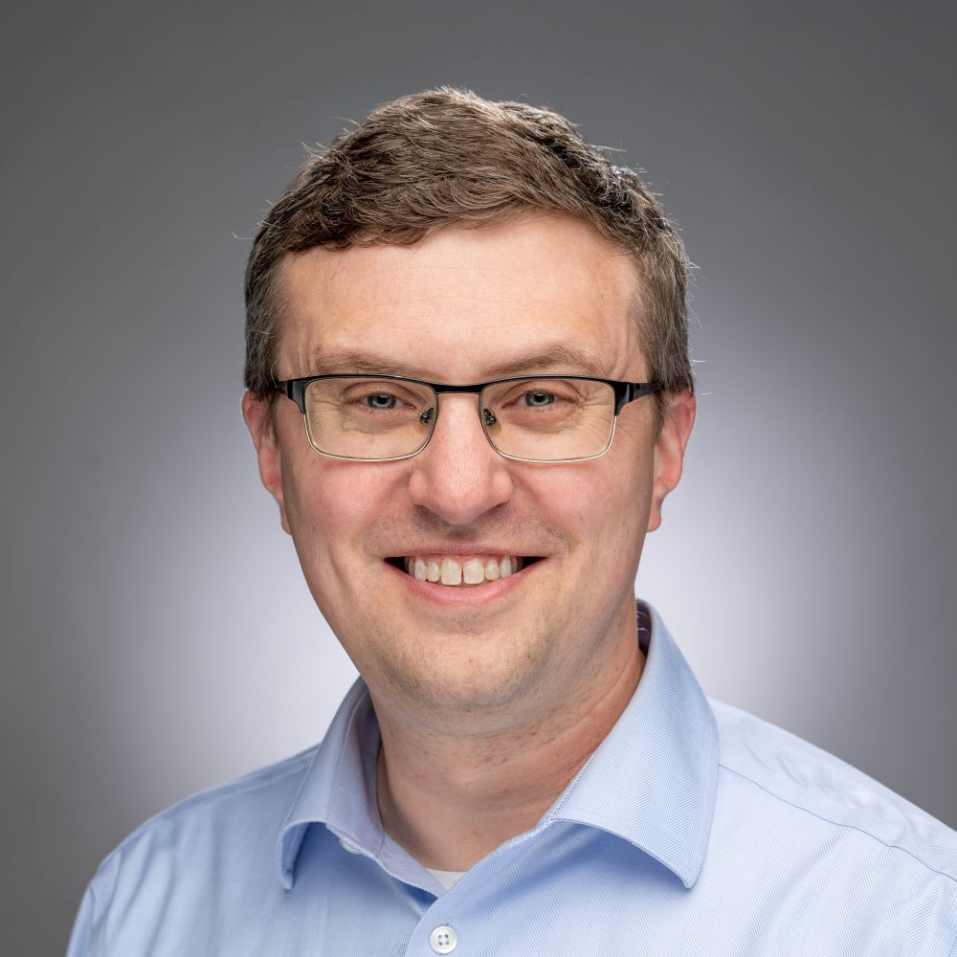
Guest Speaker
Former Director of Vanderbilt University Center for Teaching
Ph.D. in Mathematics (Vanderbilt U)
Author of two teaching-related books
Podcaster – (Intentional Teaching 2022 – present)
Intentional Teaching Newsletter
Dr. Derek Bruff

Slide 28
Thank you for attending!

